Slide 1

Mental health, vulnerability and policing
9th December 2022
Julie Cameron, Associate Director

Slide 2
What will we cover?
Who is Mental Health Foundation?
Prevention approach
Why is this required?
What can be done?
  Prevention economics
  Becoming a Man
  Together to Thrive Dundee
Any questions

Slide 3




MHF Vision and Values
Our vision is good mental health for all (not just for some)
Our mission is to help people understand, protect and sustain their mental health
Notes:
This was articulated in our strategy Making prevention happen – focus on prevention and increasingly inequalities

Slide 4
Our strategic focus
Public Mental Health (Prevention + Equality)
No one living in the UK is deprived of the opportunity for good mental health as a result of social barriers.
Those at greatest risk of poor mental health receive preventative support through a sustainable, community-based delivery model.
Anyone who has questions about looking after their mental health and supporting the people around them, has confidence to seek help and can find the advice and resources they need.
Priority Groups/areas
vulnerable families
at-risk young people
refugees and asylum seekers
people living with long-term conditions
Poverty and wider social determinants
Notes:
We have the how we work but what about the how?
So what are our agreed strategic objectives?
No one living in the UK is deprived of the opportunity for good mental health as a result of social barriers.
Priority areas include national government policy and the social barriers faced by our priority population groups, incl. forced migration, poverty, racism and childhood trauma.
This will include us advocating and campaigning for strong public policies on prevention and social inequalities, achieved through a mental health in all policies approach across governments and clear public mental health commitments in national mental health strategies.
Those at greatest risk of poor mental health receive psychosocial, preventative support through a sustainable, community-based delivery model.
Priority areas are vulnerable families, at-risk young people, refugees and asylum seekers, people living with long-term conditions.
We will strengthen our evidence informed public-facing advice and engagement offer, but we will focus our community programmes on testing and scaling targeted preventative interventions with population groups most affected by key issues of poverty, discrimination, gender inequality and racism
Anyone who has questions about looking after their mental health and supporting the people around them, has confidence to seek help and can find the advice and resources they need.
The priorities will be broad considering a whole population mental health promotion approach, but we are likely to further prioritise key channels and types of resource based on our focus of the above two objectives.
We will empower millions of people to support their mental health, and reduce mental health stigma, by engaging communities and stakeholders with evidence-based, accessible, relevant public mental health information that finds people where they are, using digital and non-digital means.

Slide 5

Public Mental Health Lens
Public Mental Health Approach. “Improving the mental health & wellbeing of the whole population, whilst reducing the inequities within it.”
Public mental health deals with mental health promotion, prevention of mental disorders and suicide, reducing mental health inequalities, and governance and organisation of mental health service provision. (Wahlbeck K, 2015)
Whilst acknowledging the role of genes and biomedical factors, it also takes into account the complex and interrelating social, psychological and environmental factors that influence who we are and how we live including experiences of trauma, adversity, systemic oppression and of course stigma and discrimination.
Notes:
Stigmatization of mental disorders is a widespread phenomenon that constitutes a barrier for help-seeking and for the development of health care services, and is thus a core issue in public mental health actions. For See Me to increasingly apply a public mentl health lens – with the view that essentially to tackle stigma and discriminsation as foundation to mh promotion and prevention you must recognise the problem as one that is impacted by the wider socio-economic risk factors that enable ‘othering’ and create structural inequities across all aspects of life for those with mental illness. This requires an ongoing shift from individual to targeted population work, a focus on inequalities (aligned to rights based approach and social justice model) and an emphasis on being led by evidence and translating that evidence into practice.

Slide 6
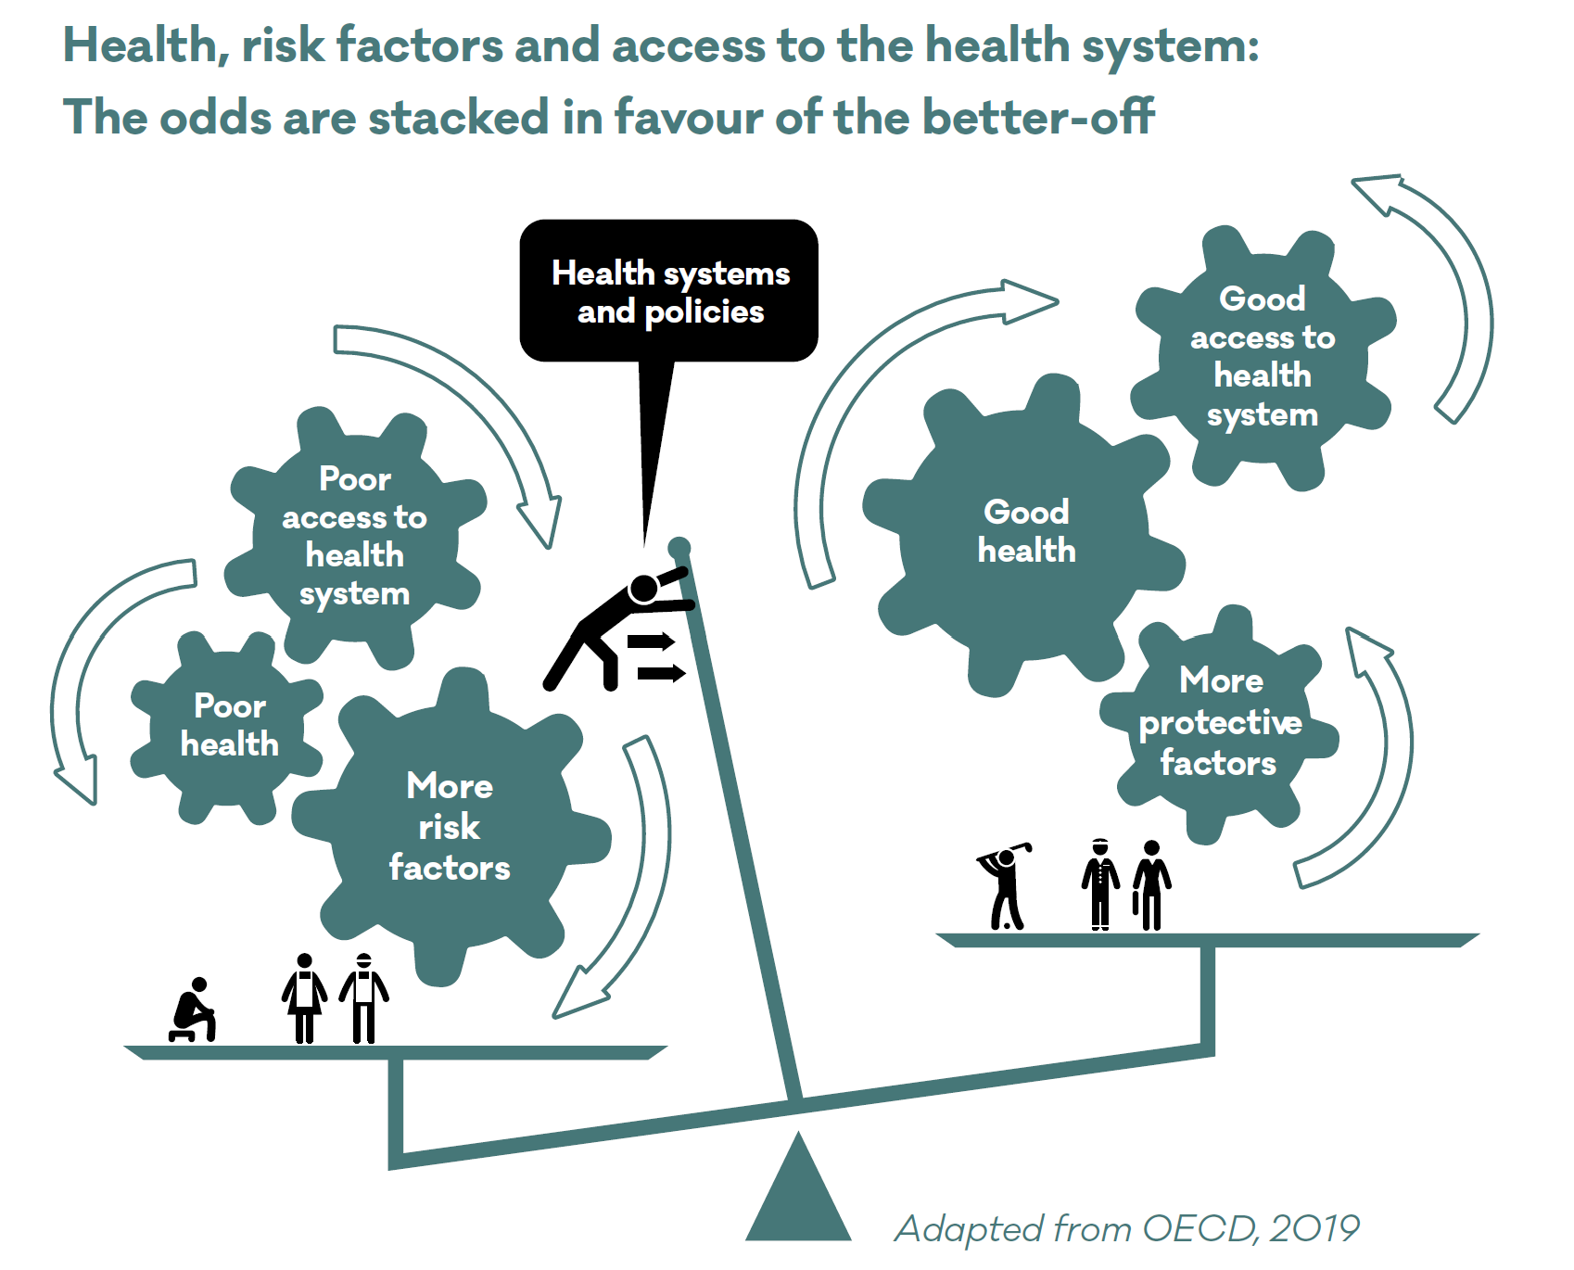
Notes:
According to the WHO, material disadvantage “trumps” emotional and cognitive advantages. In other words, people from poorer economic circumstances
are still more likely to have worse mental health, even if they have been supported to develop good emotional and cognitive skills.The best interventions do not completely overcome the disadvantages of poverty, poor education, insecure housing, and low quality work.

Slide 7
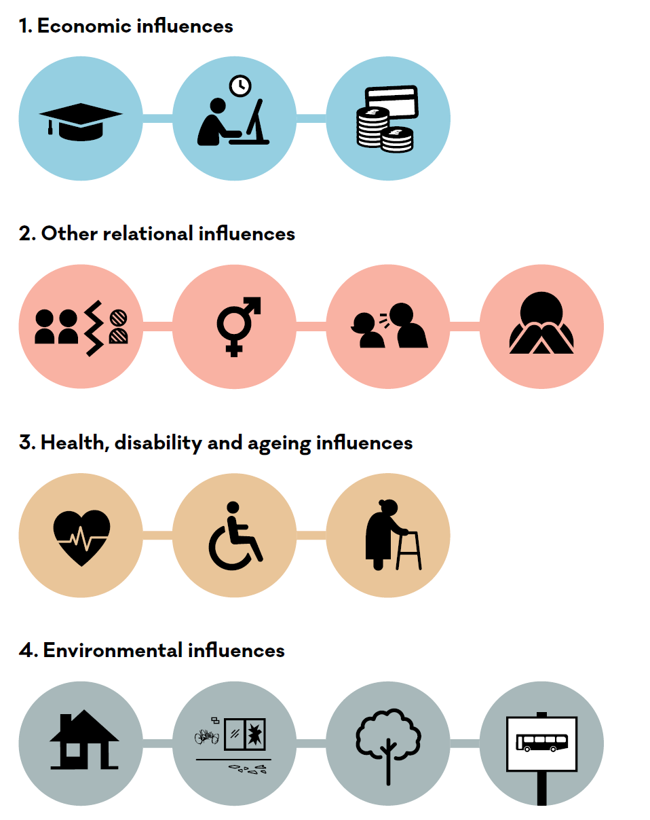
Notes:
Four categories of factors can influence our mental health:
economic (including financial position, employment status and educational attainment). This category was pulled out from other relational statuses because: income inequality/poverty is the most widely-experienced, and also widely influential. For example, children in poverty are more likely to experience adverse childhood experiences, people who are poor are more likely to live in poor quality housing, have insecurity of housing tenure, lower educational attainment and less access to green and blue space.
Other relational influences having to do with our social position and wider exposure to stigma and discrimination discrimination(gender, ethnic minority status, sexual orientation)
Health, disability and ageing – long-term health conditions, experiences of exclusion due to disablement, and ageing
Environmental influences – housing availability, security and quality, access to green and blue space, and public transport

Slide 8
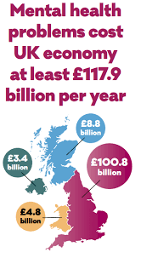
Economic influences
Poverty and Income
1M people in Scotland and ¼ of children live in poverty
2x as likely if living in deprived area to experience anxiety or depression
3x more likely to die from suicide
Children in lowest income households are 4x more likely to experience mental health problems
Employment and Education
It has been estimated that 34% of unemployed people have mental distress, compared to 16% of those in employment
Job loss has a traumatic and immediate negative impact on mental health and there is further damage when unemployment is long term.
Lower literacy and school dropout both associated with greater risk of mental health problems
60% of young people say getting a job feels ‘impossible now’.
Notes:
Economic influences includes financial position, employment status and educational attainment.
Significant in current climate where there is increase in job insecurity. Princes Trust poll of over 2000 16 to 25 year olds conducted post pandemic 6-0% said getting a job feels ‘impossible now’ and ¼ that the pandemic has destroyed their career aspirations.
Mental Health Foundation. (2022). The economic case for investing in the prevention of mental health conditions in the UK. Retrieved from: https://www.mentalhealth.org.uk/sites/default/files/2022-06/MHFInvesting-in-Prevention-Full-Report.pdf.
Young people overall seem to be struggling more 2018 SALSUS study of 13 and 15 year olds previous 12 years mental health is getting worse – increase in abnormal scores using strengths and difficulties questionnaire and decrease in the WEMWBS average score

Slide 9
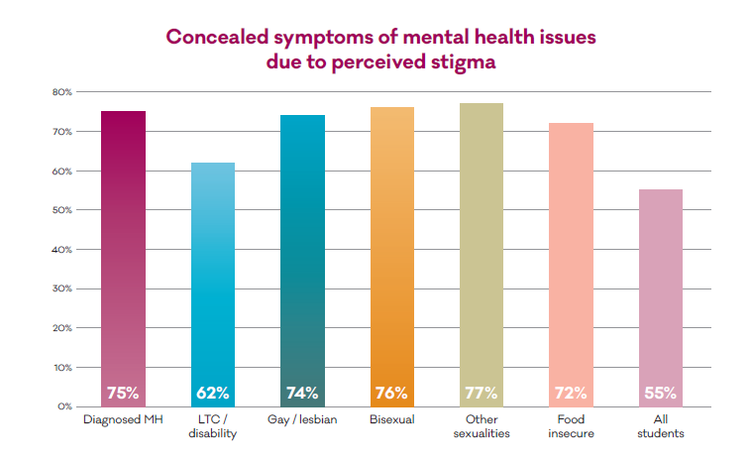
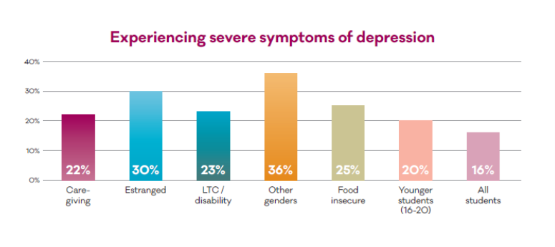
Relational influences
Identity and Adversity
Being identified with a particular cultural or social group can bring with it a higher risk of mental health problems when it leads to adverse experiences. This includes those:
  with caring role
  Experience of being in care
  Refugee status/asylum seekers
  LGBTQ+
  With wider experience of discrimination including racism, bullying based on sexual orientation, gender identify, sexism etc.
Transition and childhood trauma
Adversity in childhood is directly responsible for 29.8% of adult mental health problems.
Adversity in adulthood (trauma) is a risk factor for mental health problems
Two of the greatest barriers to children receiving mental health support are low levels of mental health literacy and fear of stigmatisation
Notes:
Thriving Learners study – two year study into student mental health – year one focus on univesity students and year two college. Most recent was college students where 54% of students indicated that they had moderately, moderately severe or sever symptoms of depression. This slide just shows those with most severe symptoms
Two of the greatest barriers to children receiving mental health support are low levels of mental health literacy and fear of stigmatisation
Refugees and asylum seekers are more likely to experience mental health problems than the general population, including higher rates of depression, post-traumatic stress disorder (PTSD) and other anxiety disorders.

Slide 10
Health, disability and ageing influences
Disability and long term conditions
People with long-term health conditions are 2x to 3x more likely to experience mental health problems , with anxiety problems or mood disorders being particularly common.
People with physical, sensory or intellectual disabilities are at higher risk of having a mental health problem
Gender and age
More than 1 in every 10 UK women are affected by postnatal depression within a year of giving birth
Gendered differences between women and men in rates of common mental health problems such as anxiety (15% and 13%) and including eating disorders (8.6% and 4.0%), self-harm (9% and 5%) and suicide (6.7% and 21.6%)
11% of pensioners were in persistent poverty after housing costs between 2016-2020
Notes:
Being homeless or at risk of homelessness is strongly associated with mental health problems
Poor quality housing, and housing that is unsafe and insecure, are risk factors for poor mental health and the exacerbation of existing mental health problems
Urbanisation and urban living
are linked to mental health stressors such as areas with concentrations of socioeconomic deprivation, low social
support, social segregation, and stressors in the physical environment such as air, water and noise pollution, as well as exposure to physical threats (accidents and violence
Burden falls to the poor, women and ethnic minorities
Mental health inequalities in UK were high pre-Covid
Our study with Cambridge and Strathclyde shows they have magnified
This is leading to
Greater mental illness and distress
Widening inequalities
Physical and mental health syndemics
NHS pressures
Deaths of despair (suicide, addiction)
A crisis now exacerbated by the cost of living crisis
(Covid: mental health in the pandemic, MHF, University Cambridge, Strathclyde, 2020-22 -4000 adults repeat survey)

Slide 11
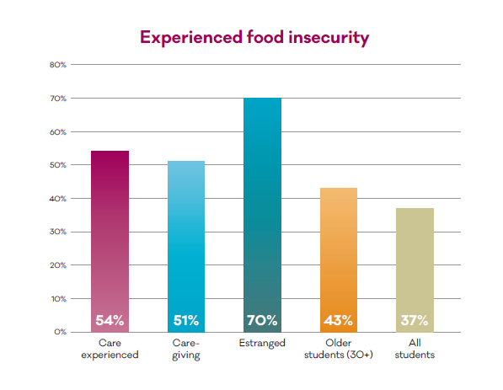
Environmental influences
Safe & secure housing / immediate needs met
Connected communities
Access to green and blue space
MHF covid study (13 waves of data)
The crisis has had wide and deep emotional impacts on Scottish adults.
Falling anxiety levels
Increase in loneliness
Increase in hopelessness
https://www.mentalhealth.org.uk/our-work/research/coronavirus-mental-health-pandemic-study-scotland
Notes:
Being homeless or at risk of homelessness is strongly associated with mental health problems
Poor quality housing, and housing that is unsafe and insecure, are risk factors for poor mental health and the exacerbation of existing mental health problems
Urbanisation and urban living
are linked to mental health stressors such as areas with concentrations of socioeconomic deprivation, low social
support, social segregation, and stressors in the physical environment such as air, water and noise pollution, as well as exposure to physical threats (accidents and violence
Burden falls to the poor, women and ethnic minorities
Mental health inequalities in UK were high pre-Covid
Our study with Cambridge and Strathclyde shows they have magnified
This is leading to
Greater mental illness and distress
Widening inequalities
Physical and mental health syndemics
NHS pressures
Deaths of despair (suicide, addiction)
A crisis now exacerbated by the cost of living crisis
(Covid: mental health in the pandemic, MHF, University Cambridge, Strathclyde, 2020-22 -4000 adults repeat survey)

Slide 12
Prevention
Fund health & community interventions that work
(The Economic Case for investing in the prevention of mental health problems in the UK: LSE/MHF/Strathclyde, 2022)
Notes:
Mental Health Training for Health Visitors: Training all health visitors to identify women at risk of perinatal depression and providing psychological therapies for those at risk.
Parenting Programmes: Evidence-based parenting programmes for the whole population and for those where a specific need for parenting support has been identified.
Anti-bullying programmes in schools
Exercise Opportunities: Opportunities to engage in exercise for all children, young people, and adults
Identifying adults at risk of poor mental health early and providing them with psychosocial or psychological support (remote or face-to-face)
Supporting those with mental health difficulties in the workplace: i.e., by providing brief psychological support for those who need it; alongside actions to change workplace cultures to promote and protect mental health
Brief interventions for people living with long-term physical health conditions
Social Opportunities for Older People: Providing opportunities for older people to continue to engage in activities that reduce their risk of social isolation.
Suicide prevention measures: in addition to restricting access to means, early identification of risks of future self-harm, for instance in hospitals and in primary care, followed by appropriate ongoing mental health support

Slide 13
Examples from practice
Mental Health in all Policies
Becoming A Man
  Increased investment in evidenced interventions for public health and prevention of mental health problems.
  Mental Health Strategy should take a cross-departmental approach … recognising the benefits of improved preventive work in mental health for other life outcomes and vice versa.
Notes:
A cross-departmental ‘mental health in all policies’ forum should be established to monitor and implement the strategy.
The Scottish Government should improve the transparency of funding allocated to preventing mental health problems on a cross-departmental basis at both national and level levels
Informed by lived experience – not just mental health but risk factors

Slide 14



Examples from practice: Programmes
Covid Response Programme / Together to Thrive

Slide 15
What does success look like?
A fundamental shift in key health and social policies that take a mental health in all policies approach and that lead to improved mental health for people in Scotland, and across UK.
Community preventive mental health support available for people in our key priority groups providing a stronger evidence base to take to scale.
Millions of people more empowered to manage and support their mental health.

Slide 16
Questions ?
jcameron@mentalhealth.org.uk

Slide 17
References
Scottish Government. (2022). Poverty and income inequality statistics. Retrieved from: https://www.gov.scot/collections/poverty-and-income-inequality-statistics/.To Public Health Scotland. (2021).
Overview of mental health and wellbeing. Retrieved from: http://www.healthscotland.scot/health-topics/mental-health-and-wellbeing/overview-of-mental-health-andwellbeing.
Public Health Scotland. (2018). Child poverty in Scotland: health impact and health inequalities. Retrieved from: http://www.healthscotland.scot/media/2186/child-poverty-impact-inequalities-2018.pdf.
Mental Health Foundation. Long-term physical conditions and mental health. Retrieved from: https://www.mentalhealth.org.uk/explore-mental-health/a-z-topics/long-term-physical-conditions-andmental-health.
Tempany M. (2009). What Research tells us about the Mental Health and Psychosocial Wellbeing of Sudanese Refugees: A Literature Review. Transcult Psychiatry. 46(2):300–15
The Princes’ Trust (2018). Youth Index 2018. Retrieved from: https://www.princes-trust.org.uk/ aboutthe-trust/research-policies-reports/youthindex-2018.
General Register Office for Scotland. (2020). Scotland’s Population 2019: The Registrar General’s Annual Review of Demographic Trends. General Register Office for Scotland
NHS. Overview – Postnatal depression. Retrieved from: https://www.nhs.uk/mentalhealth/conditions/post-natal-depression/overview/.
Gulliver, A., Griffiths, K. M., & Cristensen, H. (2010). Perceived barriers and facilitators to mental health help-seeking in young people: A systematic review. BMC Psychiatry, 10, 113.
Maguire, C. & Cameron, J. (2021). Thriving Learners, The Mental Health Foundation https://www.mentalhealth.org.uk/our-work/research/thriving-learners
Mental Health Foundation. (2022). The economic case for investing in the prevention of mental health conditions in the UK. Retrieved from: https://www.mentalhealth.org.uk/sites/default/files/2022-06/MHFInvesting-in-Prevention-Full-Report.pdf.
Mental Health Foundation and Independent Age. (2022). The Mental Health Experiences of Older People During the Pandemic. Retrieved from: https://www.mentalhealth.org.uk/sites/default/files/final%20PDF%20The%20Mental%20Health%20Experiences%20of%20Older%20People%20in%20the%20Pandemic%20%281%29.pdf
Notes:
Economic Case for Investing in prevention - Mental health problems currently cost the UK approximately £118 billion a year annually 5% of UK GDP in 2019)- £8.8 billion in Scotland Identified a no. of preventative interventions – mh training for health visitors (focus on perinatal mh and identification of depression) – parenting programmes – anti-bullying programmes – Exercise opportunities - Identifying adults at risk of poor mental health early and providing them with psychosocial or psychological support (remote or face-to-face) - workplace interventions – brief psychological interventions for those with long term health conditions – social opportunities for older people and suicide prevention interventions (access to means, early intervention and ongoing mental health support)

