Slide 1
Transformational Redesign Unit
Mental Health, Vulnerability and Police:
Collaborative & preventative approaches to improving outcomes in complexity
Diana Hekerem
Improvement Hub
Enabling health and social care improvement
Notes:
Alternative title and layout slides

Slide 2
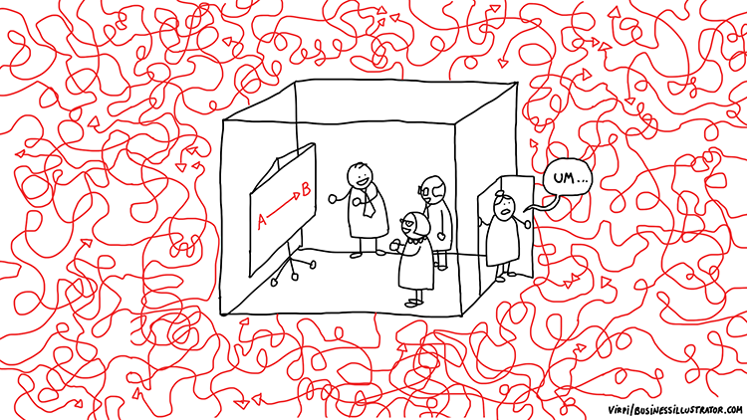
This is the reality in many areas, but especially in health and social care:

Slide 3
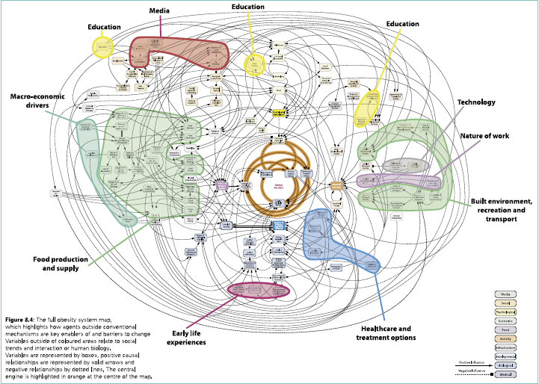
An example of complexity – obesity map:
Vandenbroeck, P., Goossens, J. and Clemens, M. (2007), Foresight Tackling Obesities:
Future Choices – Building the Obesity System Map, London: Government Office for
Science
295153/07-1177-obesity-system-atlas.pdf

Slide 4
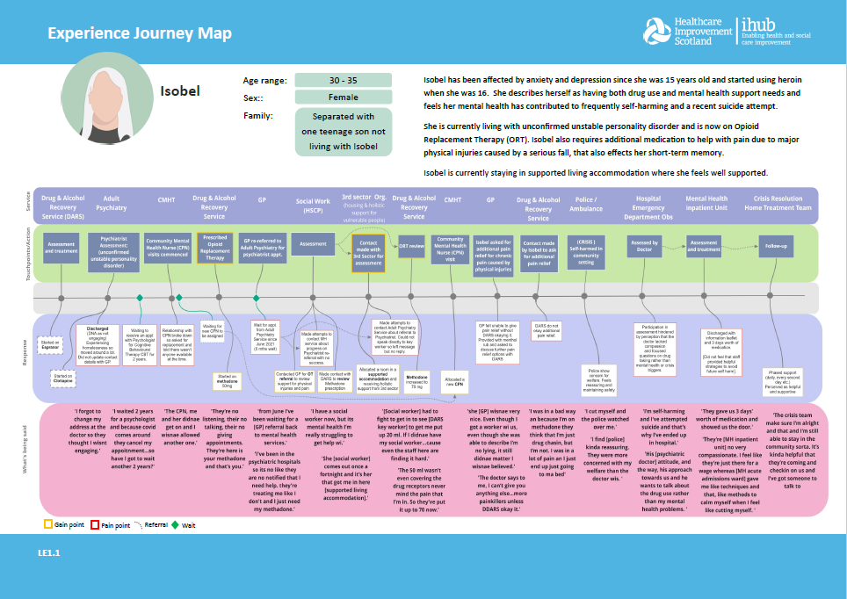
ihub Approach to Discovery
Understanding the Experience of People with Lived and Living Experience – Experience Journey Map

Slide 5
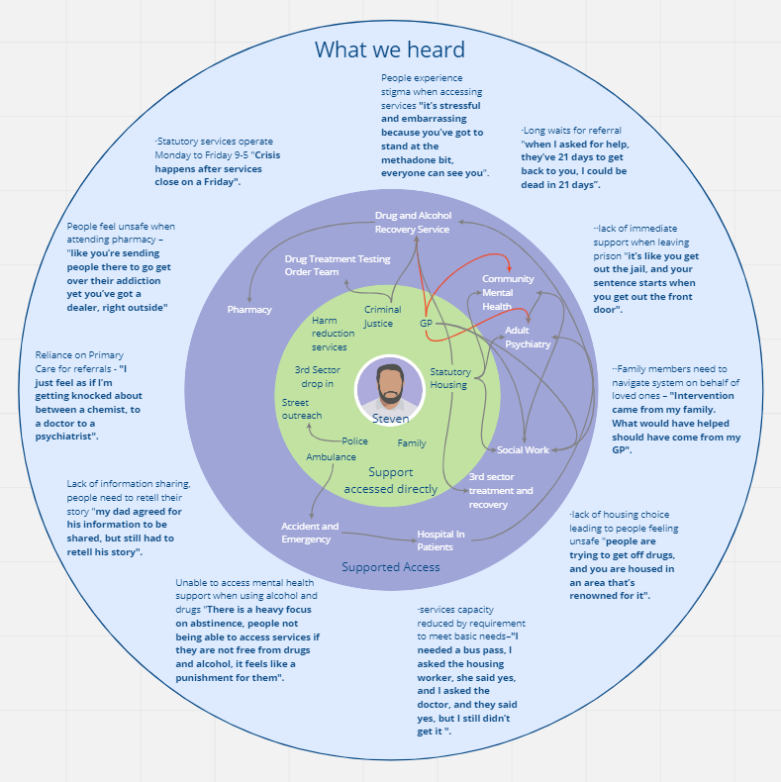
ihub Approach to Discovery
Understanding the Experience of People with Lived and Living Experience – Experience Journey Map

Slide 6
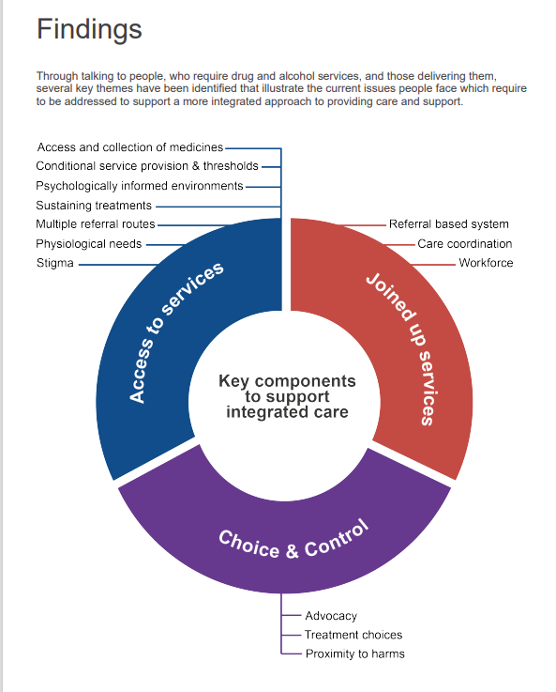
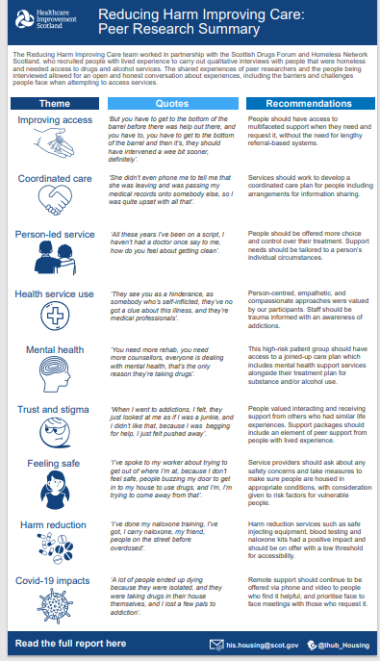

Slide 7
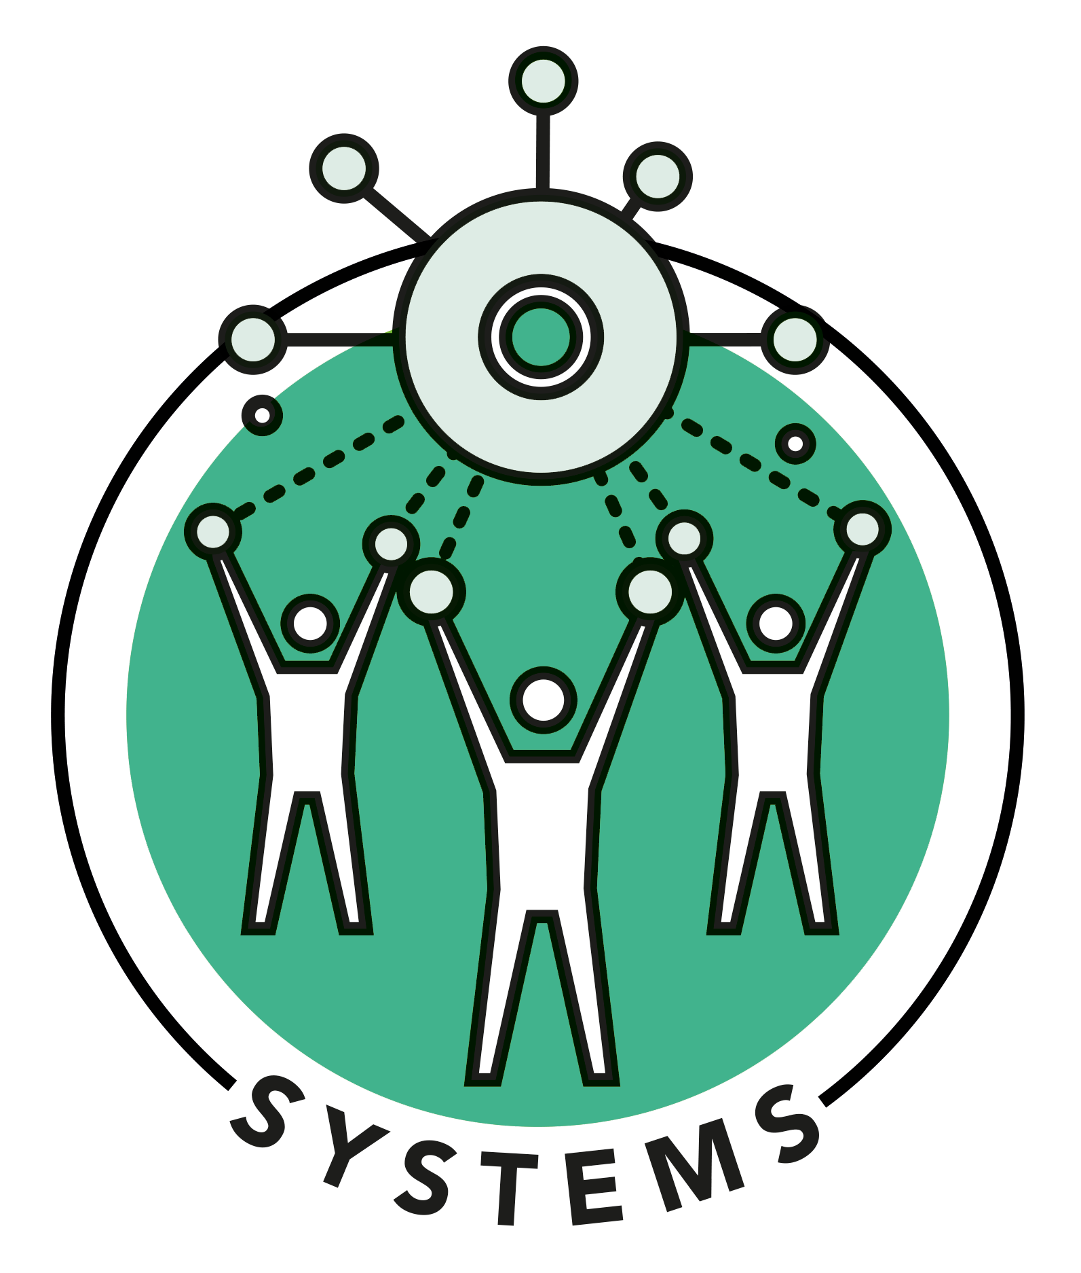
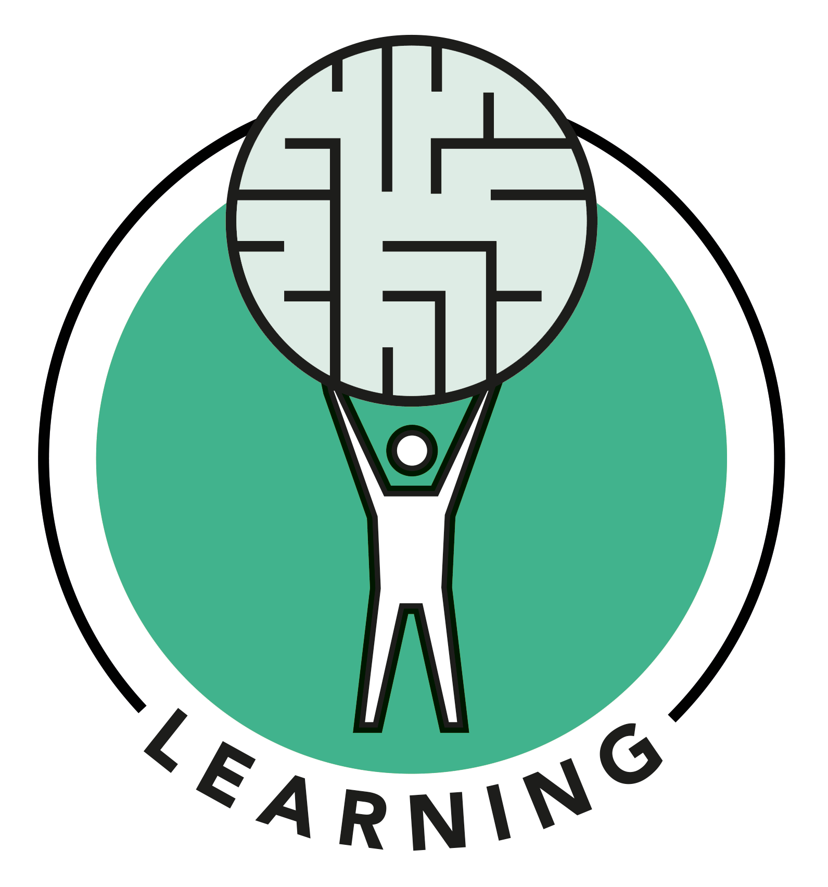
How can public management respond
to this reality?
Learning as a management strategy
Human Learning Systems –
Human Learning Systems (ihub.scot)

Slide 8
Keep In Touch With Us!
Keep in touch with our teams by emailing his.transformationalredesign@nhs.scot.

