Slide 1
Distress Brief Intervention (DBI):
Building Connected; Compassionate; Support for People Presenting in Distress
Kevin O’Neill, National DBI Programme Manager,
Chief Superintendent Matt Richards, Divisional Commander of Partnerships, Preventions and Community Wellbeing Division
Inspector Danny Clark, Police Scotland DBI Lead
www.dbi.scot / #dbi_scot

Slide 2
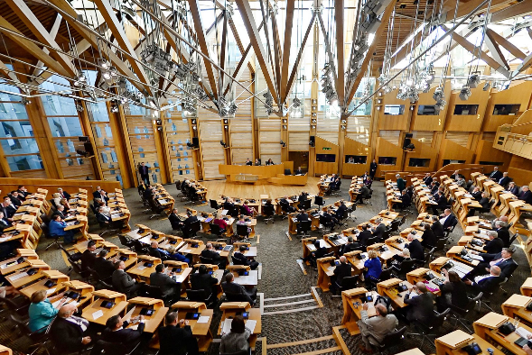
DBI Journey
National Commitment: Suicide Prevention and Mental Health Strategy.
Two year national engagement programme and review of evidence (2013-2015).
Scottish Government announce DBI Programme (2016).
Programme for Government (2018)
16 & 17 year olds
Under 16
Associate Programme
DBI National Response (April 2020)
National DBI Pathway via NHS24
Programme for Government (Sep 2020) & Mental Health Transition & Recovery Plan (Oct 2020.)
Transition, Blended & Embedded
Transition & Recovery (2021)
National Police Scotland & SAS Contact Points
University of Glasgow: Distress Module & DBI Digitisation Toolkit.
c
2
www.dbi.scot
Notes:
2

Slide 3
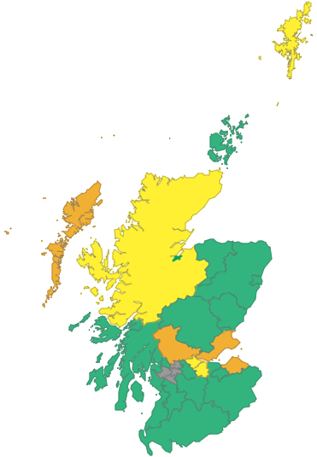
DBI Regional & National Growth Map
DBI Live
Preparing & Committed to Go Live
DBI Formal Expressions of Interest
In Discussion
DBI Live:
North & South Lanarkshire, Scottish Borders, Aberdeen City,
Inverness City, Moray, North, East & South Ayrshire, Inverclyde,
Midlothian, Dumfries & Galloway, Orkney, West Dunbartonshire,
Angus, Perth & Kinross, Dundee City, Edinburgh City, Argyll & Bute
and Aberdeenshire.
Preparing & Committed to go live:
Western Isles, Clackmannanshire, Stirling, East Lothian and Fife.
DBI Formal Expression of Interest:
Highland, Falkirk, West Lothian and Shetland.
In Discussion:
East Dunbartonshire, East Renfrewshire, Glasgow City and
Renfrewshire.
CY&P Under 16
Lanarkshire & Aberdeen
www.dbi.scot

Slide 4
What is DBI?
www.dbi.scot

Slide 5
Observations & Experiences
Training - Level 1: 2,448 (1,283 from Police Scotland).
31st October 2022: 33,982 referrals, 27,250 since COVID period 1st March. 2020 including 10,923 from NHS24 since mid-June 2020. Now 1,050 referrals per month for 2022 up from 323 in 2019.
3,121 of these referrals from Police Scotland (9.2% of all referrals & 13.6% of referrals for the local pathways).
The vast majority received a contact attempt within 24hrs of referral.
26% Under 26
57% Female.
High levels of engagement.
On average 2 presenting problems and 2 contributing factors
69% of referrals where from the five most deprived deciles.
10% self-reported being under the influence of alcohol/ substances at point of referral.
www.dbi.scot

Slide 6
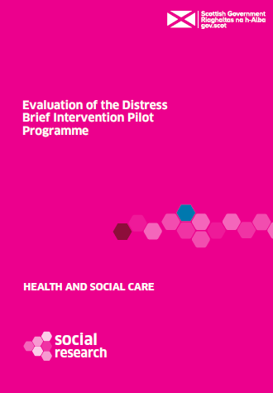
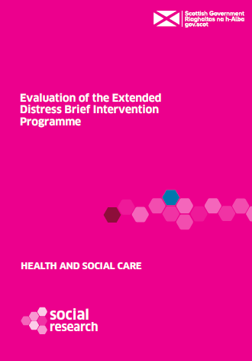
Evaluations
Levels of distress reduced over all.
Transforming cross-sectorial working.
Highly valued by front lines services and people who receive support.
High levels of compassion experienced.
Those receiving DBI, report feeling more able to manage both immediate and future distress.
Reducing suicidal behaviour.
Research Team: Nursing Midwifery and Allied Health Professions Research Unit at the University of Stirling, ScotCen, The Mental Health Foundation and Glasgow Caledonian University
www.dbi.scot

Slide 7
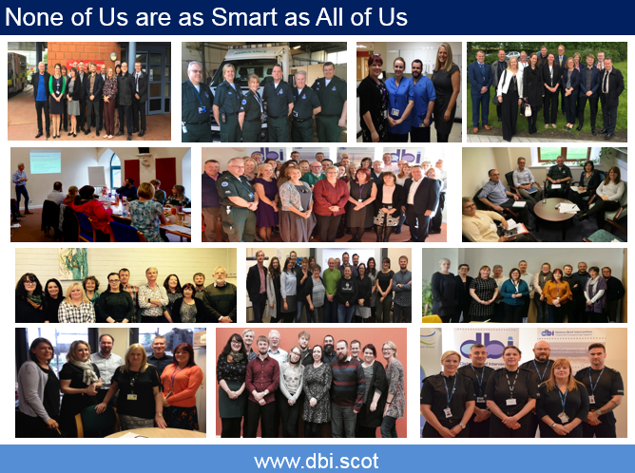
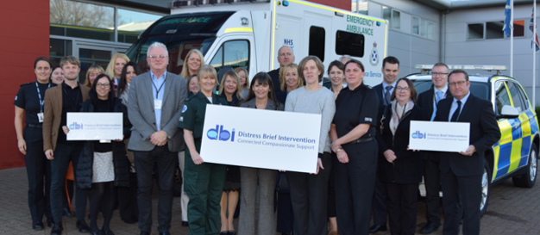
“a sensitivity to distress together with the commitment, courage and wisdom to do something about it”,

Slide 8
Building Connected Compassionate Support
A personal Reflection
Chief Superintendent Matt Richards, Divisional Commander of Partnerships, Preventions and Community Wellbeing Division
www.dbi.scot

Slide 9
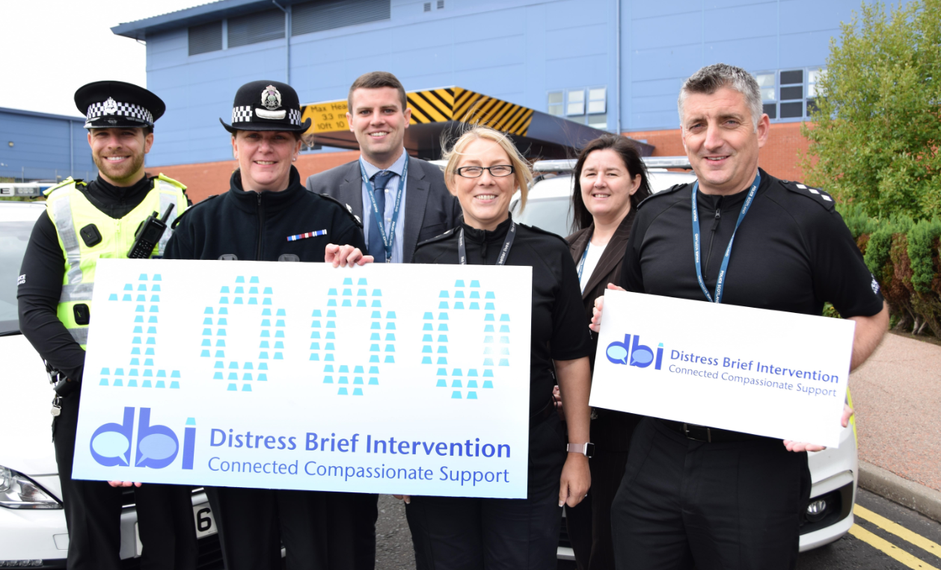
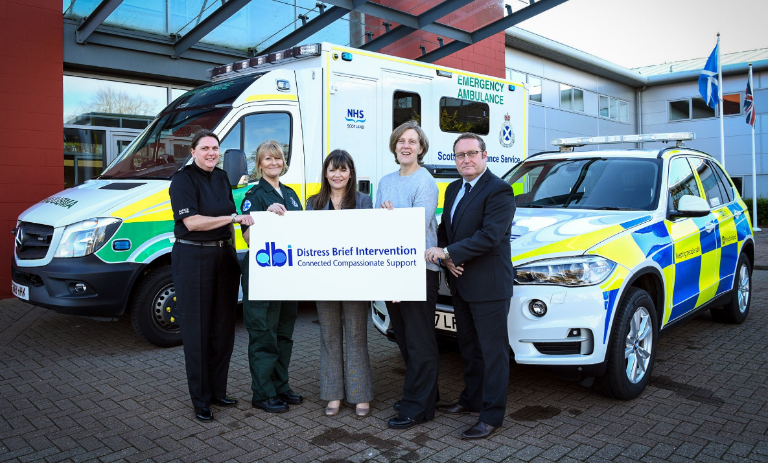
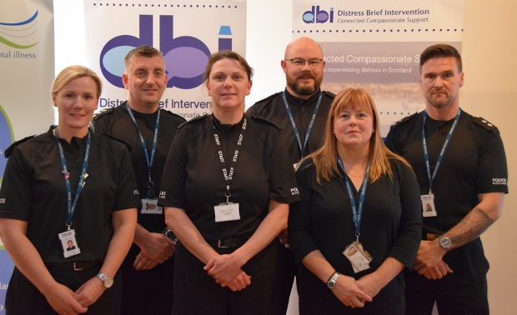
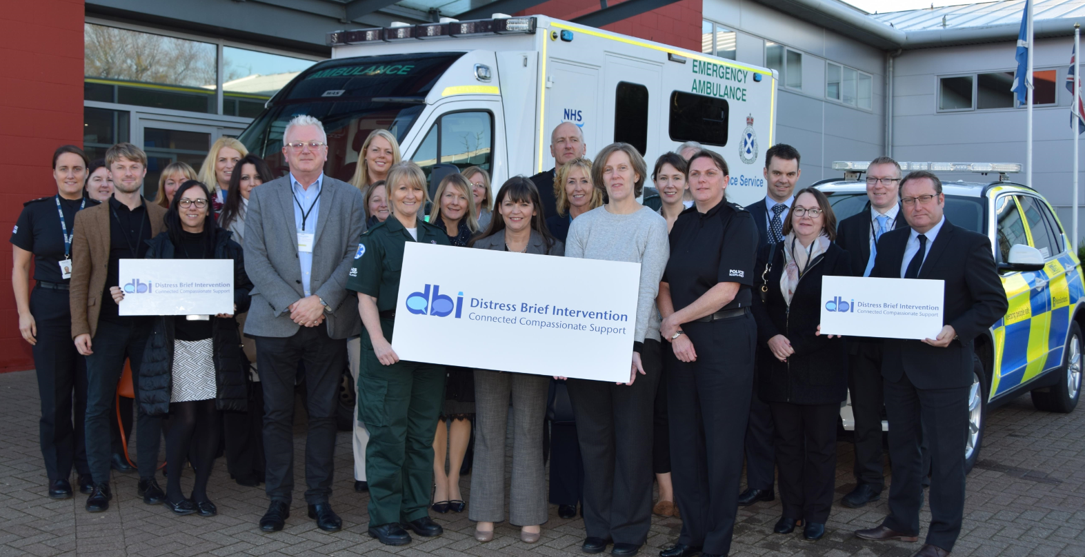
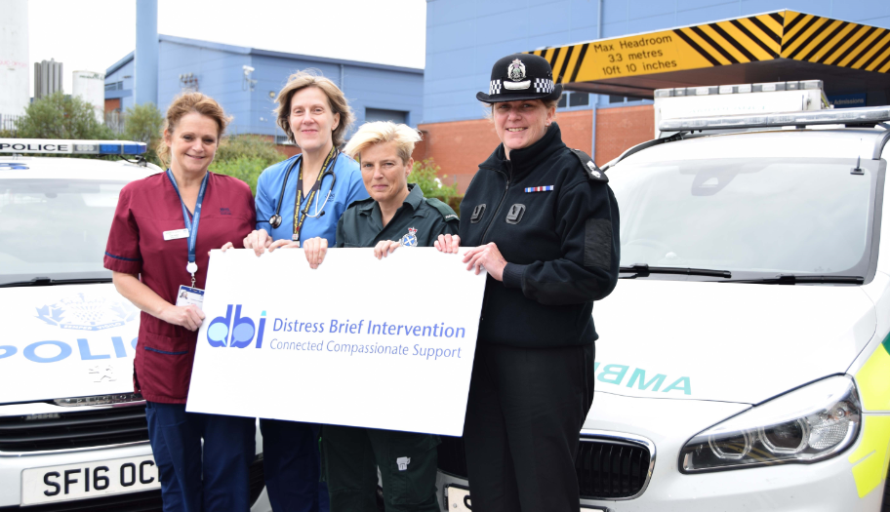
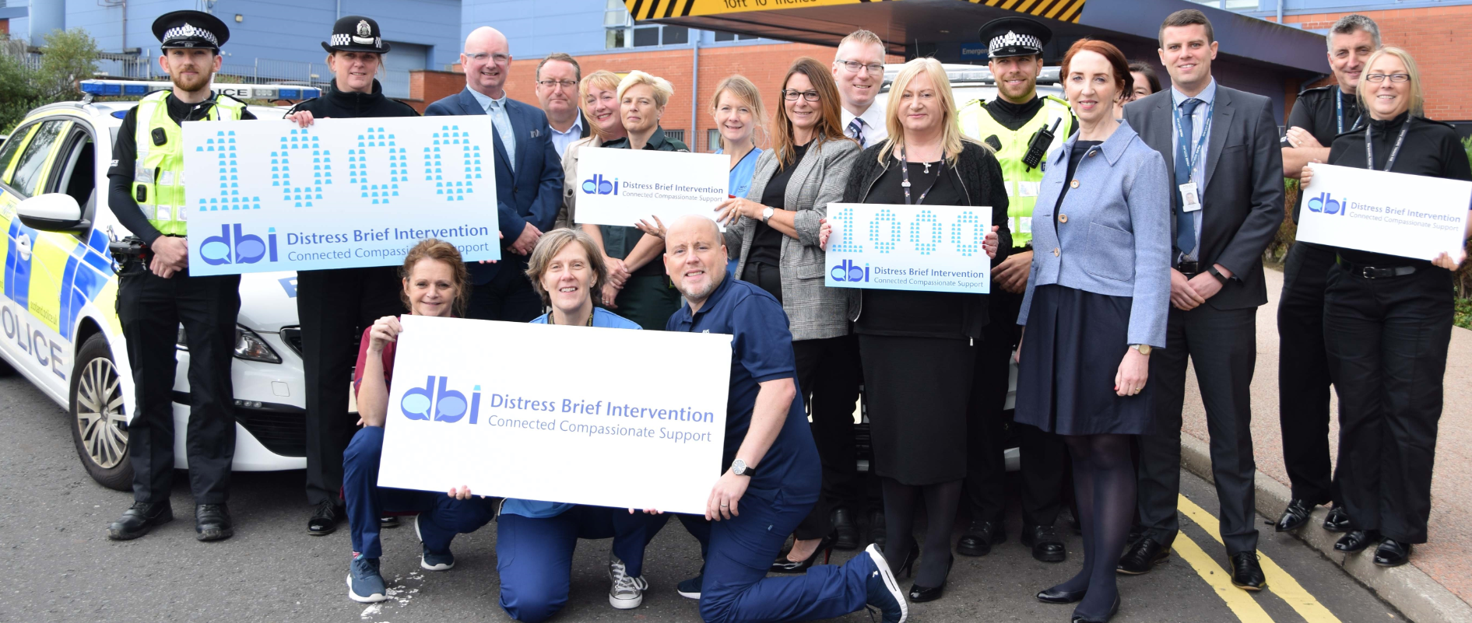
Reflections from the Frontline
www.dbi.scot

Slide 10
Reflections from the Frontline
DBI TRAINED OFFICER QUOTE:
“I think it’s a great avenue for folk that aren't quite sure of where to turn.
I think it’s a great tool for us as police officers as it’s not always criminal matters that we deal with.
If I can issue a DBI and folk engage that makes me happy as I walk away from the call feeling like I've got a good outcome. It’s a great system.”
SERVING OFFICER FAMILY MEMBERS QUOTE:
“I just want to let you know that I am so grateful for your help in getting me help through DBI.
The Level 2 provider was fantastic and has really helped me and given me the hints and tips needed that I will keep and use going forward.
I feel much calmer and crying so much less thanks to DBI. The service is worth so much more than I can explain.
Thank you once again for your help getting me in, I will be forever grateful.”
www.dbi.scot

Slide 11
Police Scotland Case Study
CIRCUMSTANCES OF POLICE SCOTLAND LEVEL 1 REFERRAL
Highly distressed male contacted Police – couldn’t gain access to his home.
Police attended - male presented as experiencing difficulties with alcohol misuse, employment, financial and isolation.
DBI referral submitted - contact made within 11 hours of submission.
ACTION TAKEN BY DBI LEVEL 2 PROVIDER
Appointment with GP re general health and alcohol misuse.
Referral to a food bank.
Urgent referral to Home Energy Scotland – received energy vouchers the following day.
Referral to DWP - application for Universal Credit fast tracked for quick payment.
Appointment at local job centre the same week - linked in with Disability Employment advisor.
www.dbi.scot

Slide 12
Police Scotland Case Study – Part 2
ACTION TAKEN BY DBI LEVEL 2 PROVIDER CONTINUED
Gym referral submitted and attendance at local Men’s Shed to aid isolation and find better ways of coping with stress.
A referral for alcohol support and Routes to Work for employment support.
OUTCOME
By the end of 14 days of support, he had food, gas, electricity and was in receipt of universal credit.
He had attended coffee and chats with people which made him feel safer, supported and respected.
Distress Management Plan in place and coping strategies develop.
He was thankful to Police for supporting him at one of his worst periods of distress.
He was grateful to DBI for supporting him throughout this time.
Starting Distress Level – 7 Final Distress Level – 2
www.dbi.scot

Slide 13
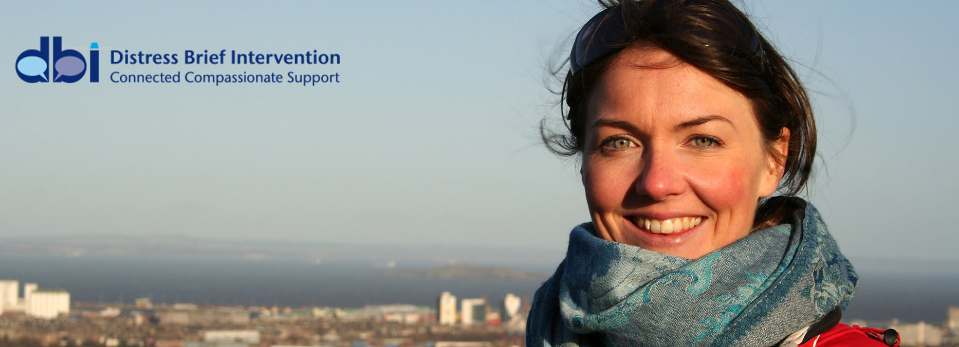
DBI Central Team: Please Contact Us
e: DBIcentral@lanarkshire.scot.nhs.uk
@: www.dbi.scot
#dbi_scot
www.dbi.scot

