Slide 1
Preventing Suicide in Scotland
Rose Fitzpatrick CBE QPM
Chair, National Suicide Prevention Leadership Group

Slide 2
Where we’ve come from

Slide 3
A three-dimensional approach
NSPLG
Lived Experience
Professional Experience
Academic Experience

Slide 5
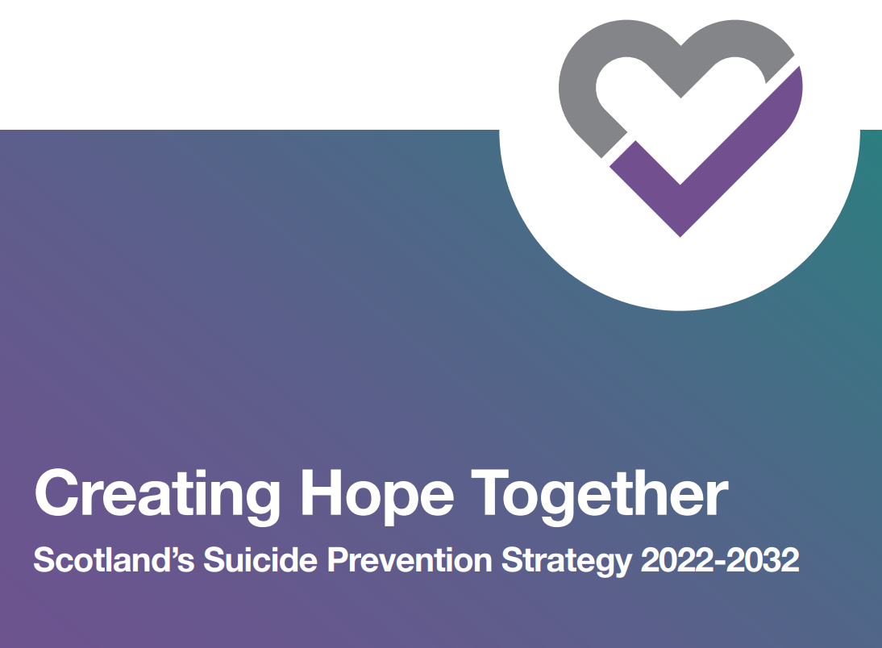
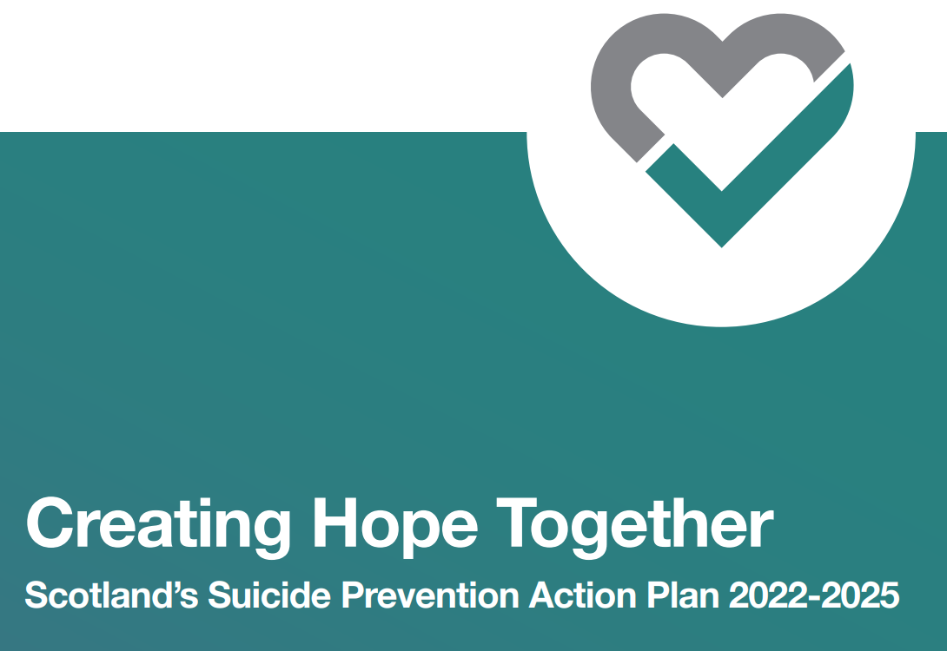
Creating Hope Together

Slide 6
Vision
Our vision is to reduce the number of suicide deaths in Scotland, whilst tackling the inequalities which contribute to suicide.
To achieve this, all sectors must come together in partnership, and we must support our communities so they become safe, compassionate, inclusive, and free of stigma.
Our aim is for any child, young person or adult who has thoughts of taking their own life, or are affected by suicide, to get the help they need and feel a sense of hope.

Slide 7
Outcomes

Slide 8
Priority Areas

Slide 9
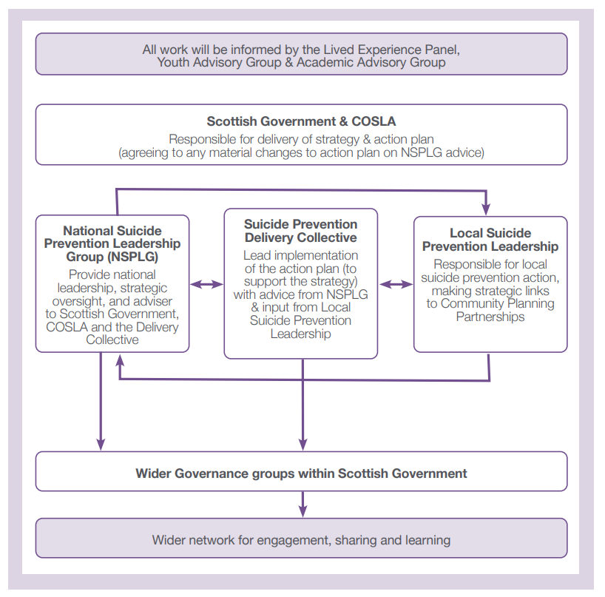

Slide 10
Leaders of all communities and organisations in Scotland can create a culture that saves lives from suicide

