Slide 1
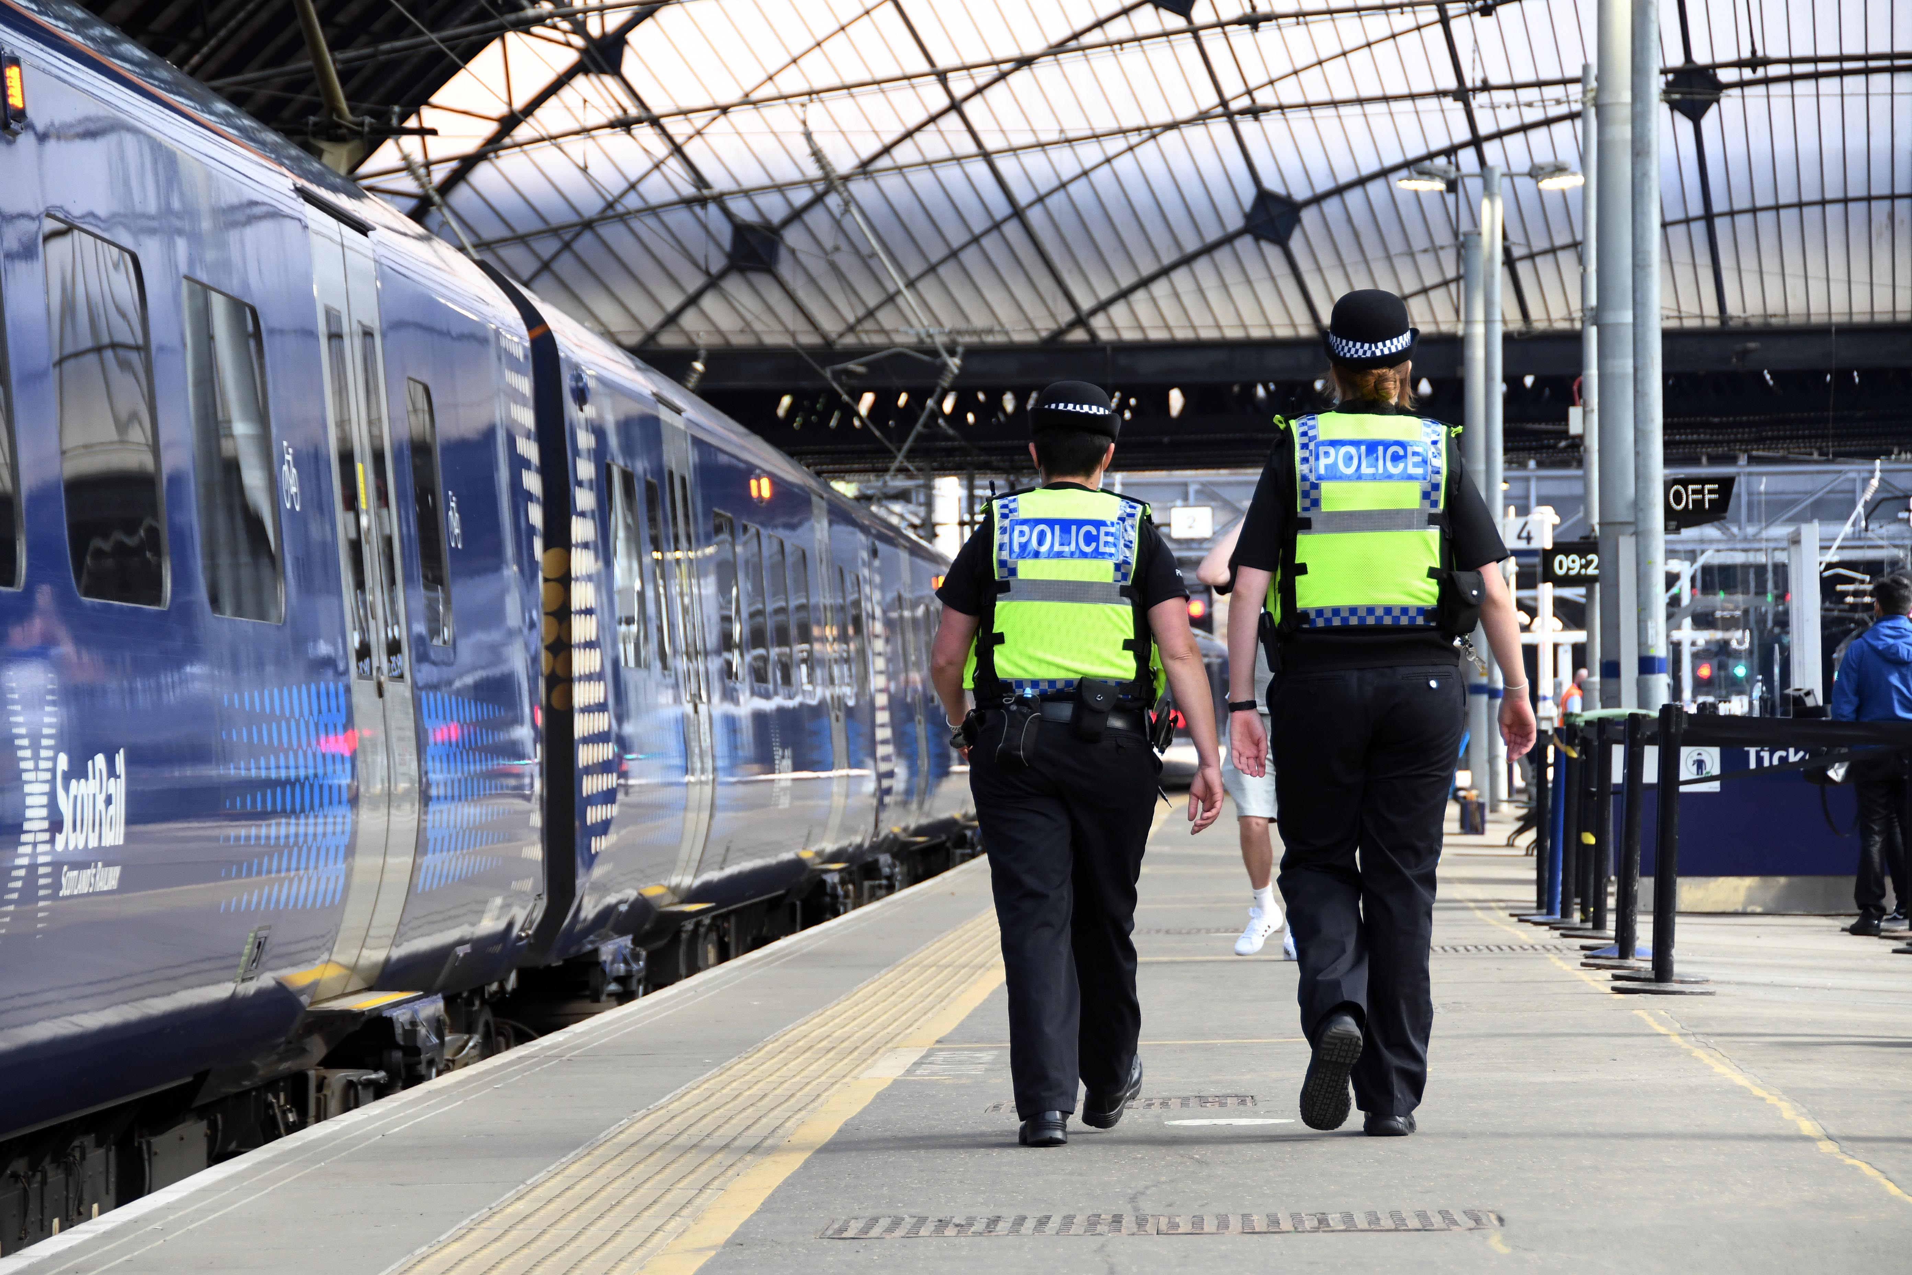
Arlene Wilson |Temporary Detective Superintendent
09/12/2022

Slide 2
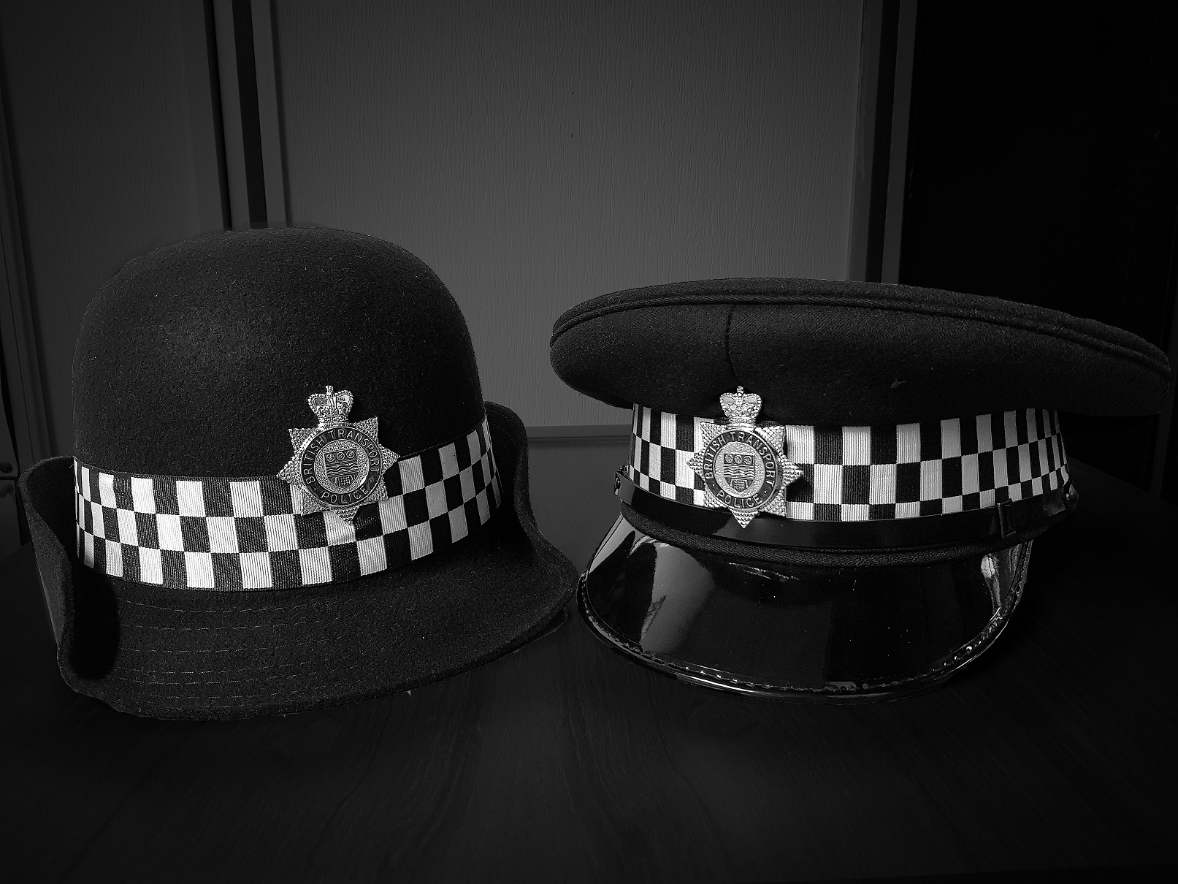
Focus for today
BTP Overview
Partnerships
HaRT – Harm Reduction Team
People come first

Slide 3
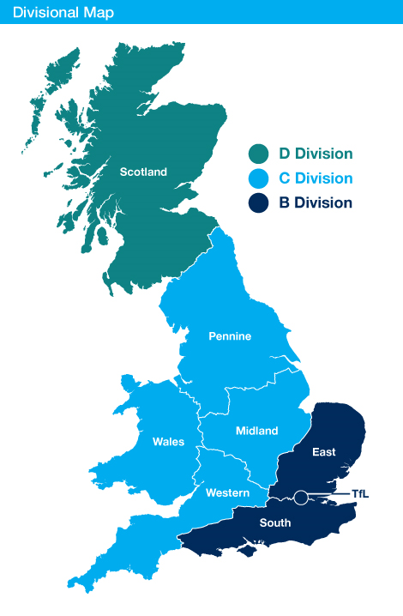
BTP Overview
BTP is the specialist police force for Britain’s railways, providing a service to rail operators, their staff and passengers across the country. This includes the Glasgow Subway, London Underground, Docklands Light Railway and Croydon Tramlink.
8.8 million passenger journeys every day
61,000 Crimes dealt with annually
88 Police Stations
3,000 Railway stations and depots
5000+ staff (3,100 Officers)
Access to 65,000 CCTV Cameras
Funded by the British Transport Police Authority (BTPA)
Scottish Railways Policing Committee (SRPC)

Slide 4
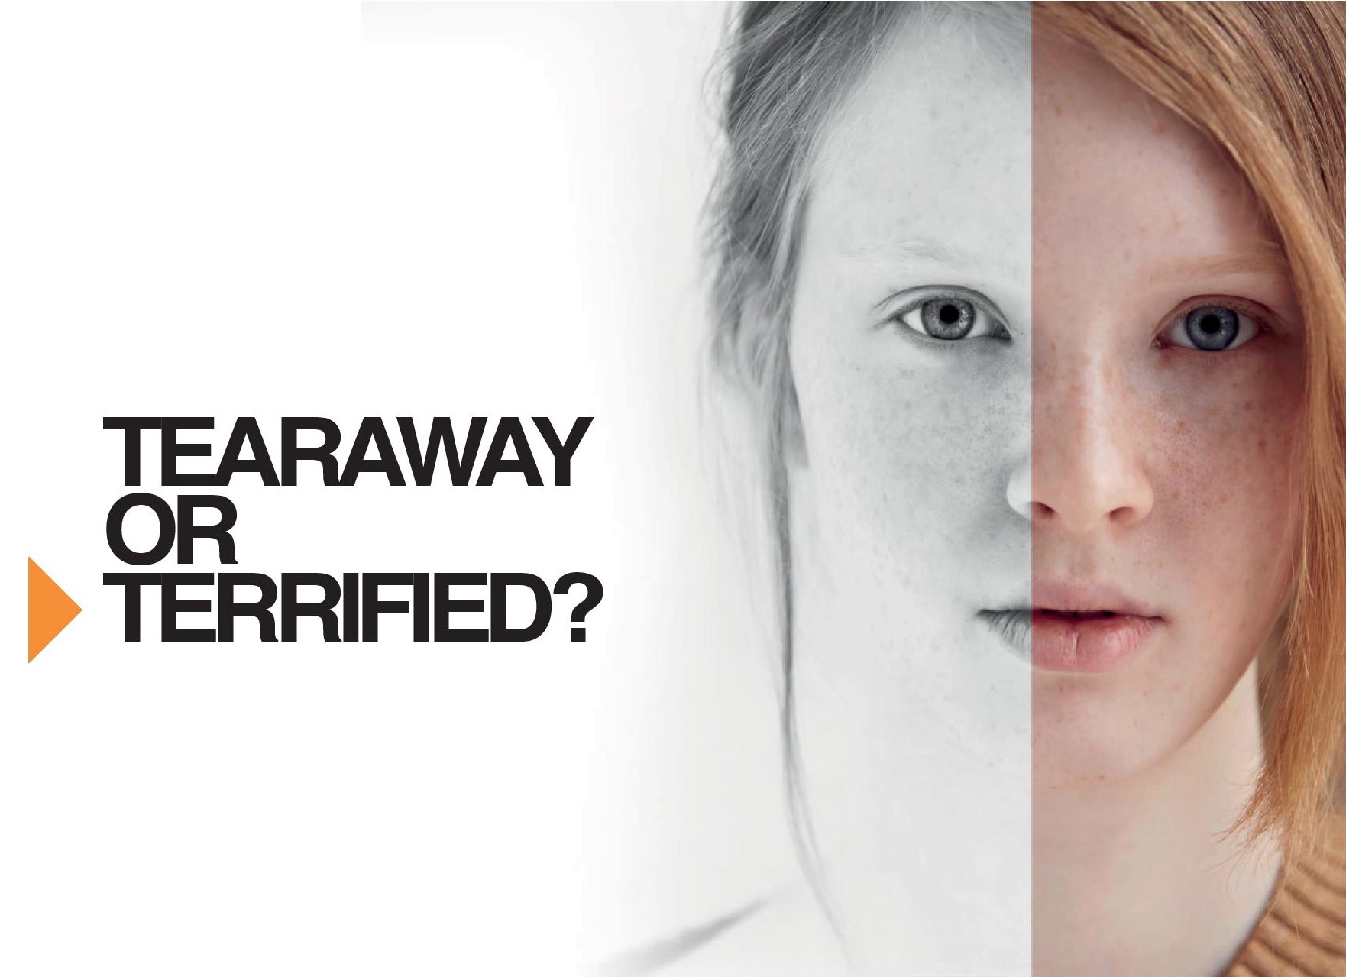
Partnerships
NPCC Suicide Prevention Lead
Rail Industry
Third Sector Connections

Slide 5
HaRT | Harm Reduction Team
Support for high frequency presenters
Educate re dangers of the railway and the impact of presentations
Conduit between BTP, Mental Health services, other support agencies ensuring a tailored approach
Reduce the number of presentations, minimising risk, reducing disruption and associated costs.
The team will not directly prosecute anyone involved in the HaRT process

Slide 6
Evaluation
42%
Did NOT attend the railways whilst under HaRT management
Detentions (BTP Only)
63%
Overall
Decrease in presentations
6%
decrease
whilst under HaRT
SIGNIFICANTLY
Reducing the impact on the rail infrastructure &Reducing the risk of serious injury/death
SUBSTANTIALLY LESS DISRUPTION
WHILST UNDER HART
6,980 delay minutes post HaRT
51,086 minutes of delays prior to HaRT intervention
59%
Did NOT attend the railways once discharged from HaRT management
Substantial Cost Saving
41% did attend the railways after discharge
HOWEVER
The number of presentations & the disruption caused whilst under HaRT and once discharged was SUBSTANTIALLY LOWER than prior to acceptance by HaRT
Taking into account the disruption caused prior to HaRT, whilst under HaRT and once discharged, as well as the costs to fund the HaRT teams

Slide 7
HaRT Nominal Demographics
67%
54%
99%
93%
84%
91%
84%
17-25
Years old
IC1
White
North European
British
Unemployed
Single
No Children
27% of individual’s allocated to HaRT are 18 years and under.
BTP differs from other forces with similar teams in that we do work with children as well as adults

Slide 8
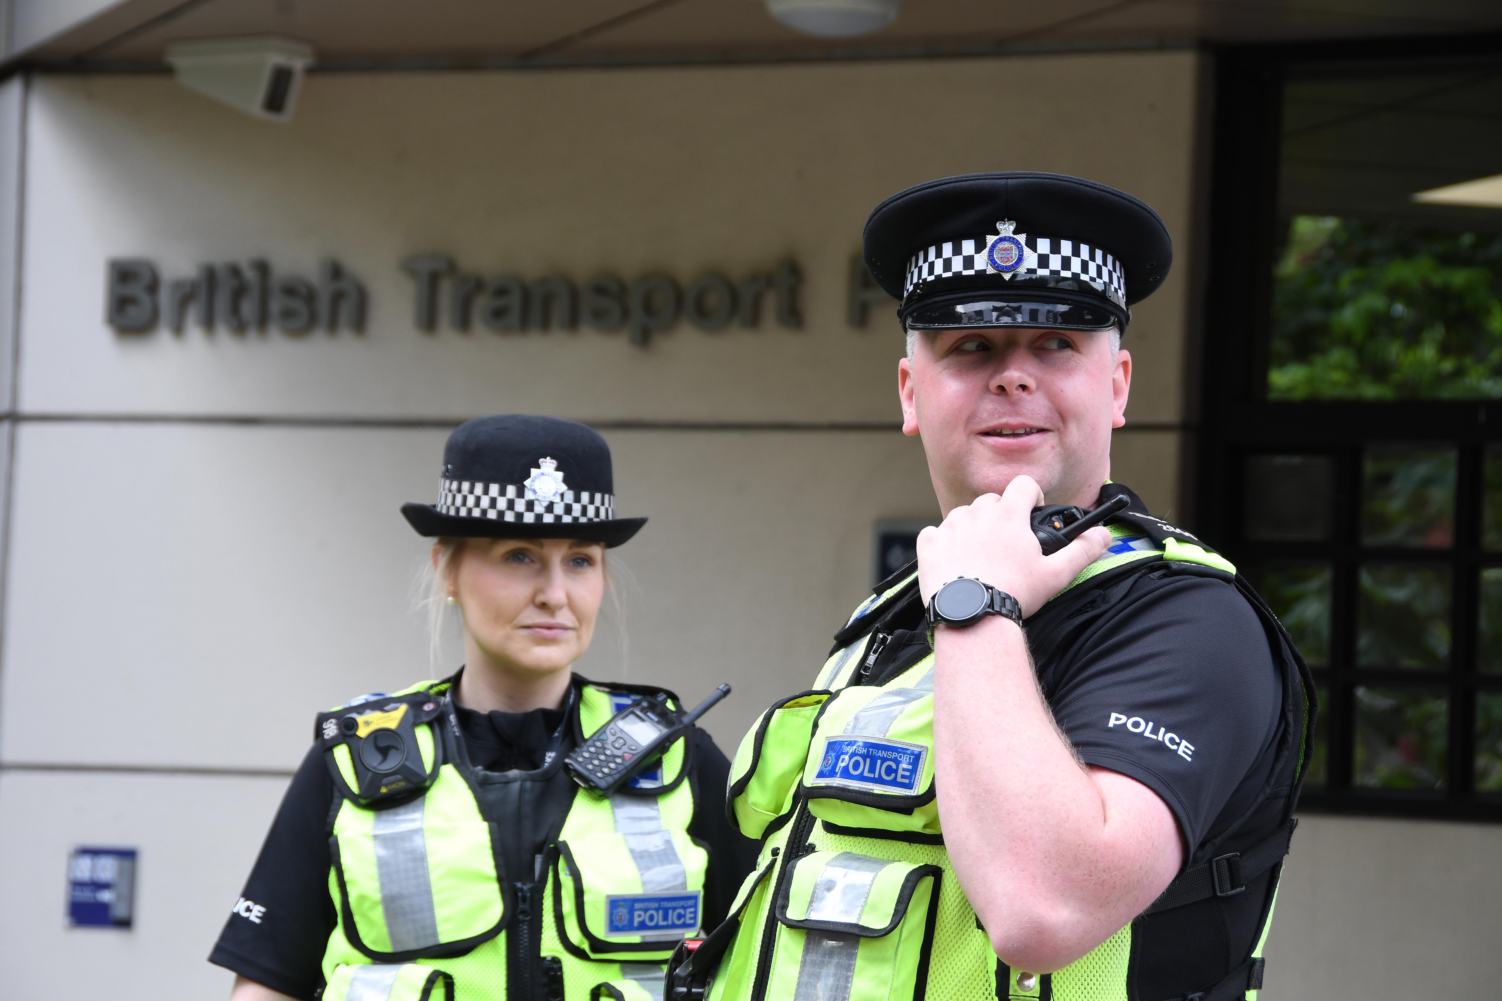
People Come First
Wellbeing hub
Psychological Framework
Coaching and mentoring

Slide 9
Arlene Wilson
0141 775 5124
07785 521 692
arlene.wilson@btp.police.uk
btp.police.uk

