Slide 1
Dealing with Complex Needs in Police Custody
Gordon McCreadie
Chief Superintendent
Criminal Justice Services Division
Hannah Cornish
Senior Programme Manager
National Police Care Network
OFFICIAL

Slide 2
Police Custody Provision
The purpose of Police Custody Provision is non-punitive.
Around 100,000 people come into custody every year.
Custody is a risk laden environment where trauma is present, visible & experienced.
Consider the custody ‘journey’…..

Slide 3
The Custody ‘Journey’
Arrest and Detention
22
Primary Custody Centres Across Scotland
Multiple Ancillary Centres
Disorientation
Removal of Liberty & Support
Legal necessity to interview at a Police Station; Increasing Trauma
At times, reducing access to local services.

Slide 4
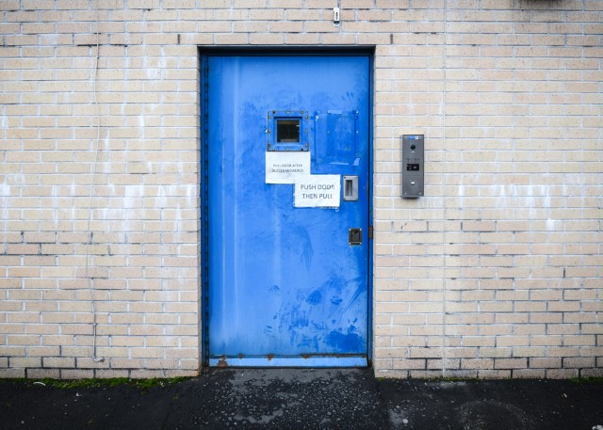
The Custody ‘Journey’
The accommodation…..

Slide 5
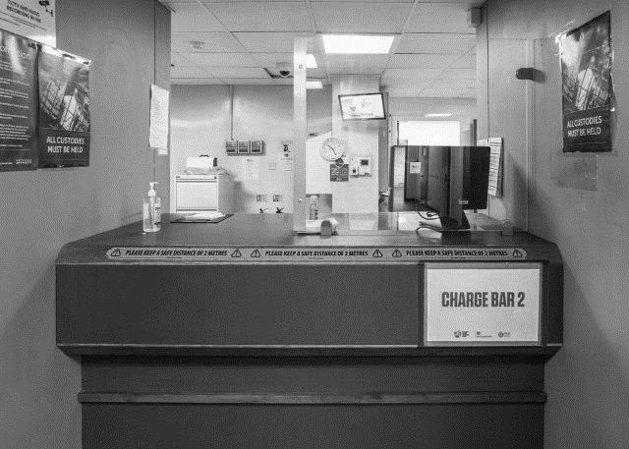
The Custody ‘Journey’
Vulnerability Assessment!

Slide 6
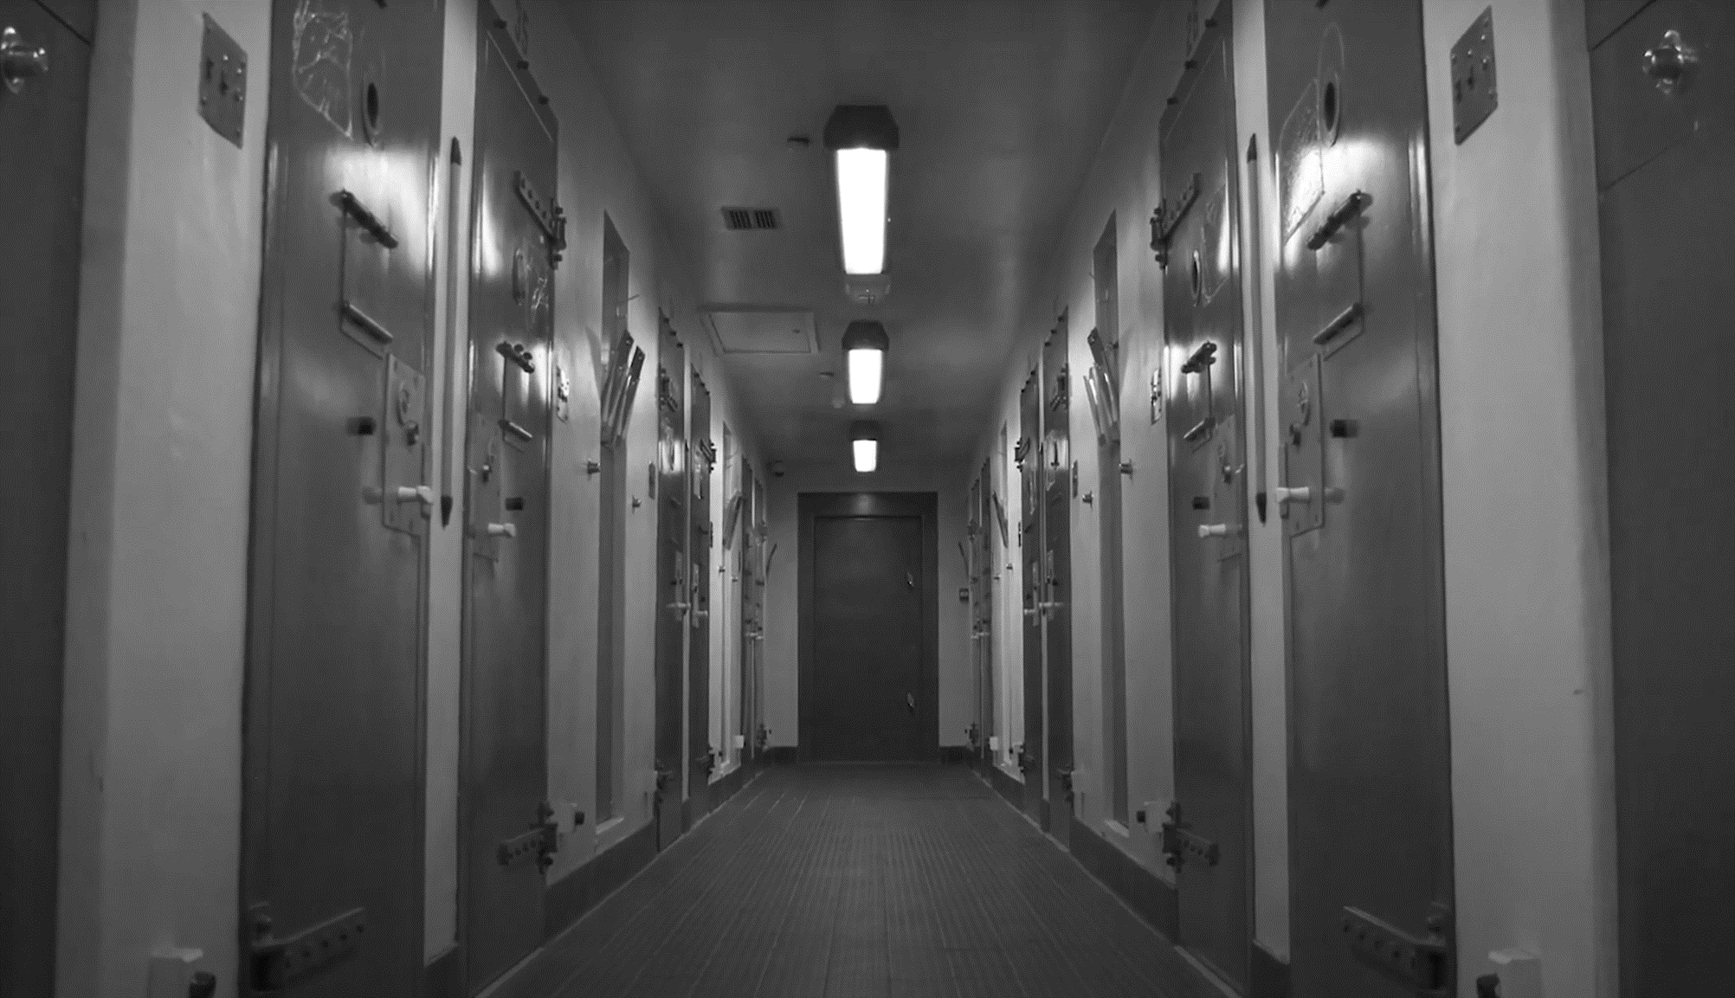
The Custody ‘Journey’
The Custody ‘Journey’
29%
Disclosed previous thoughts of self-harm or suicide
40%
disclosed current or past Mental Health Concerns
29%
disclosed previous thoughts of self-harm or suicide
6%
disclosed
current thoughts of self-harm or suicide
40%
disclosed current or past Mental Health Concerns

Slide 7
The Custody ‘Journey’
The Custody ‘Journey’
29%
Disclosed previous thoughts of self-harm or suicide
40%
disclosed current or past Mental Health Concerns
Whilst
the following film
is fictional it portrays
a realistic depiction of events
Calum's Journey

Slide 8
Healthcare Provision in Custody & The Impact on Policing

Slide 9
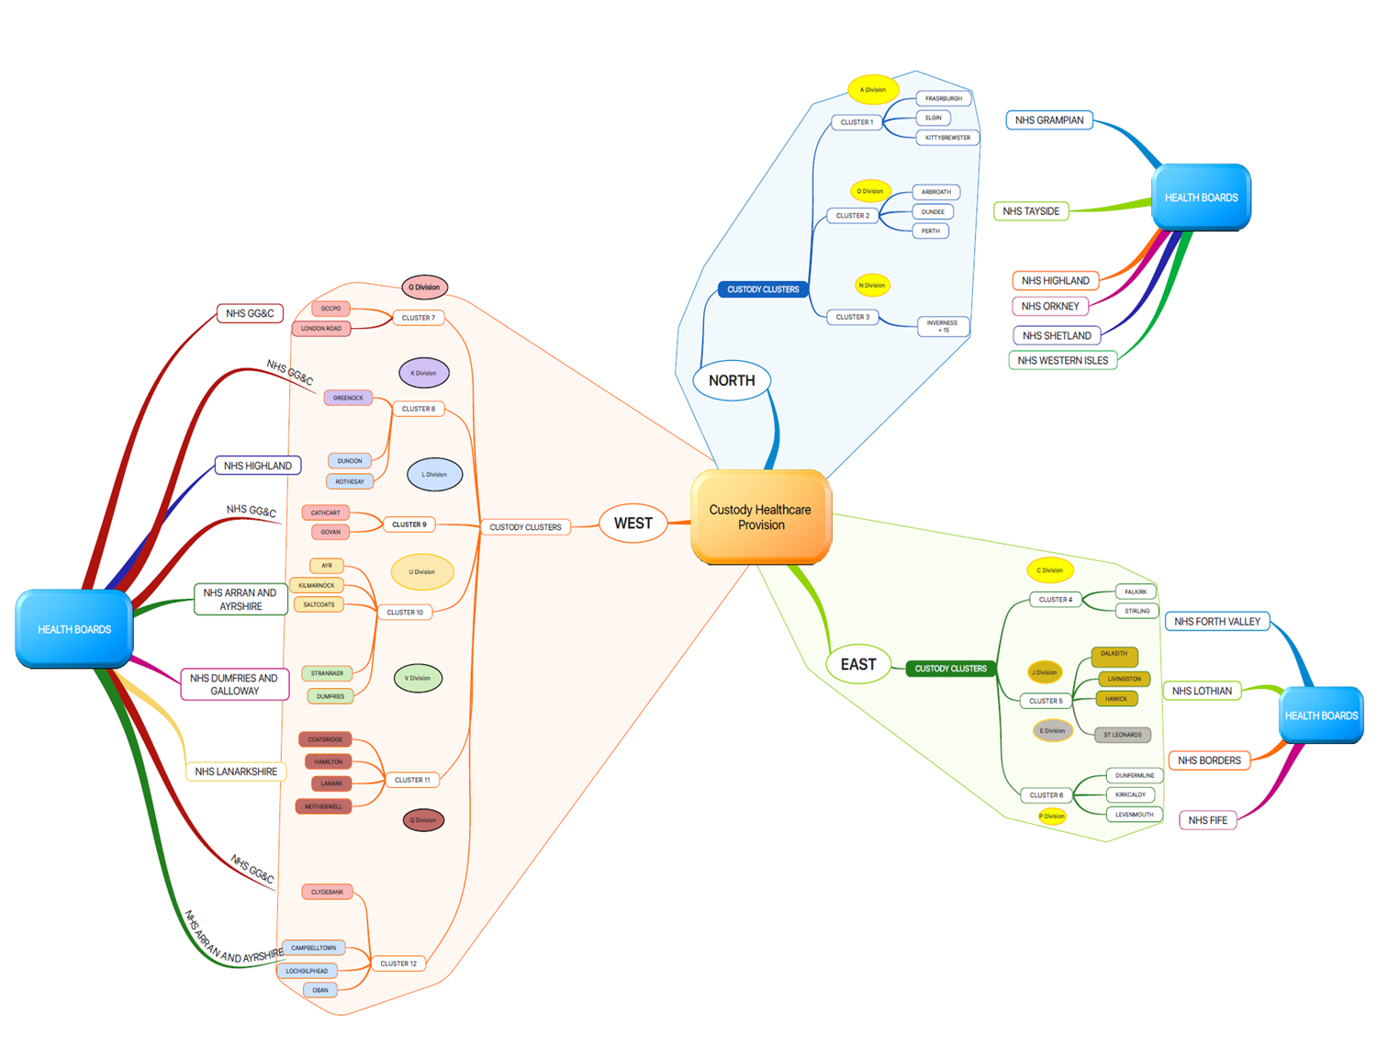

Slide 10
NHS Scotland
Police Custody Healthcare and
Forensic Medical Services
Diversion from custody
Care in custody
Onward support and referral

Slide 11
National Police Care Network

Slide 12
Thank You – Questions?

