Slide 1
The Strategic Review of Policing in England and Wales – spotlight on mental health
Ruth Halkon, Researcher

Slide 2
1. THE CHALLENGE

Slide 3
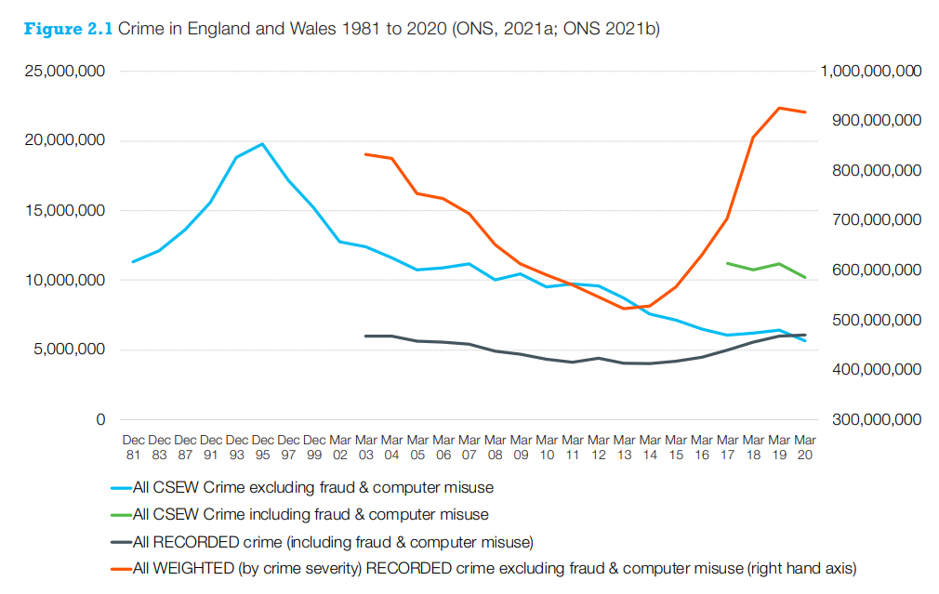
TRADITIONAL CRIME IS DOWN 75%
Notes:
The first thing to say is that traditional crime has fallen by 75% since 1995

Slide 4
TECHNOLOGY
Fraud and cyber crime offences made up 60% of crime in 2021/22, the most common type of crime experienced by people in England and Wales.
Notes:
Three TRANSFORMATIONS that are creating new forms of public safety challenge.
The first is the TECHNOLOGICAL REVOLUTION

Slide 5
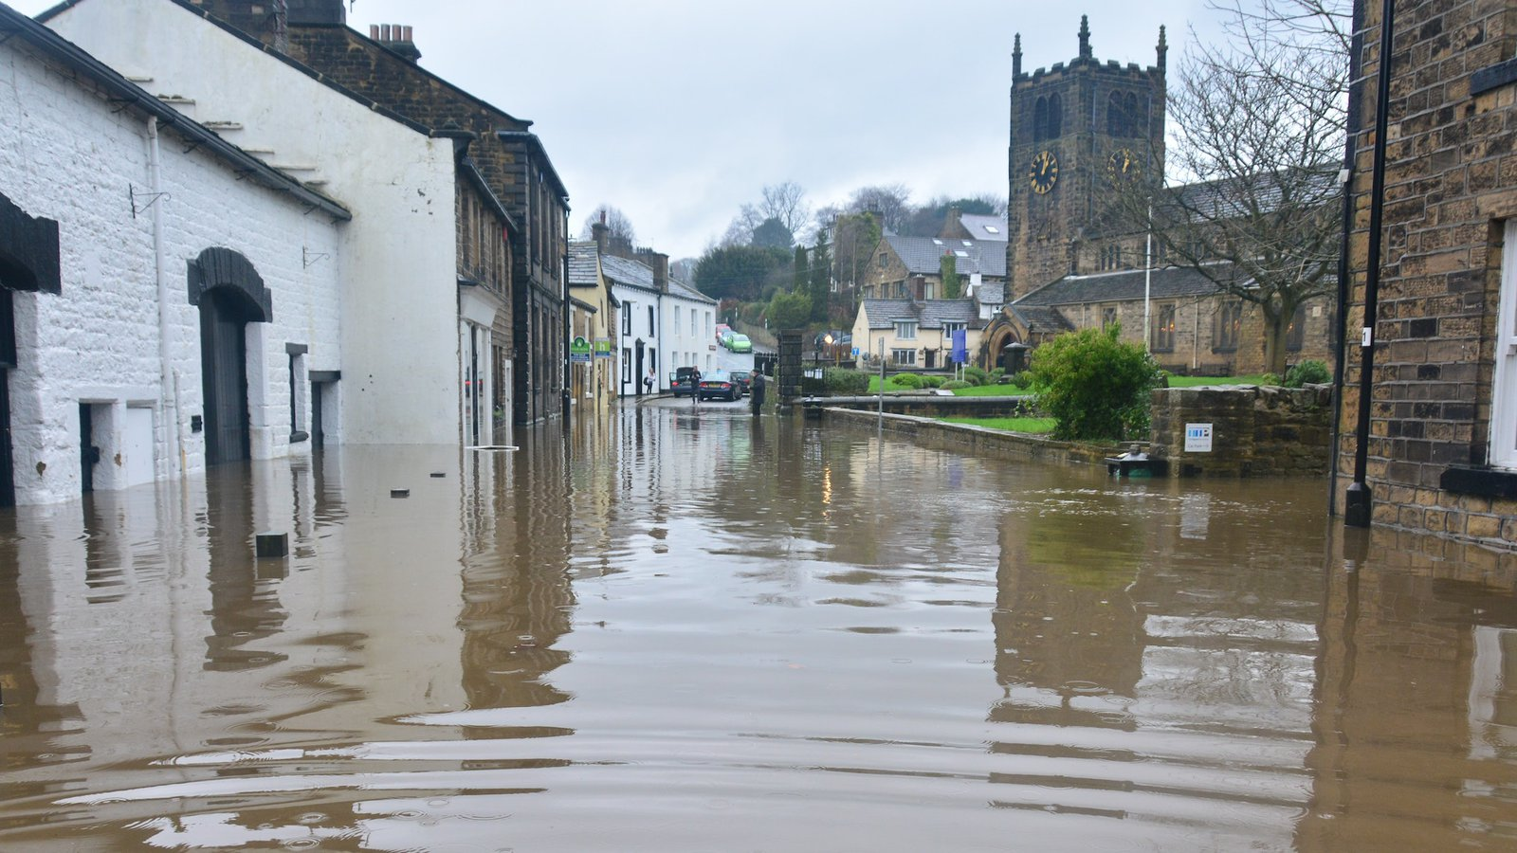
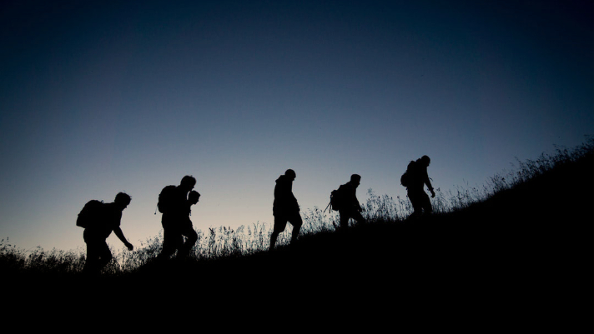
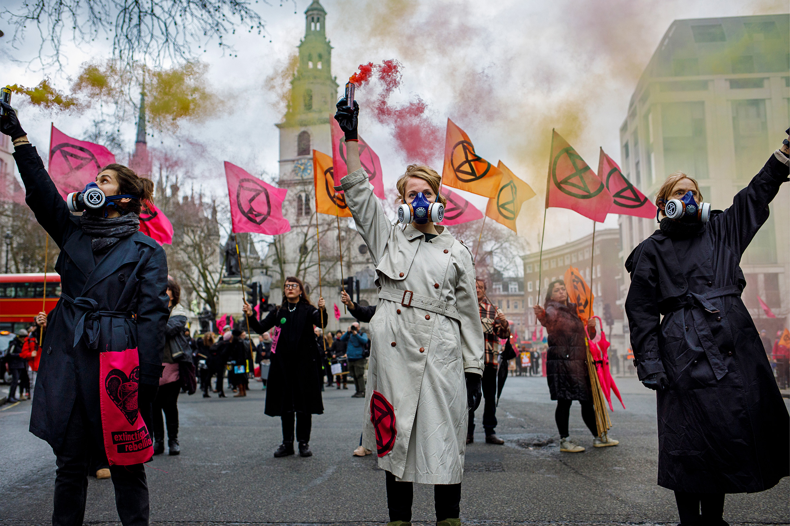
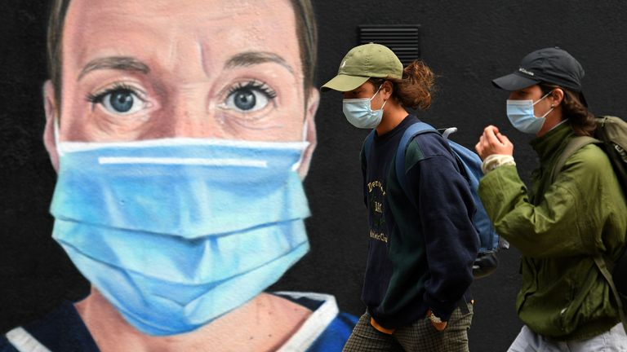
ENVIRONMENT
Notes:
The second set of changes relate to humanity’s relationship with the natural environment, out of which flow a set of public safety challenges – these include CLIMATE CHANGE and PANDEMICS

Slide 6
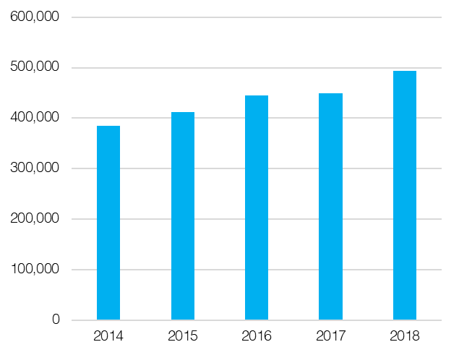
SOCIETY
Mental health incidents
Notes:
Shortage of national data on this = these figures are from BBC FOI of 36 forces

Slide 7
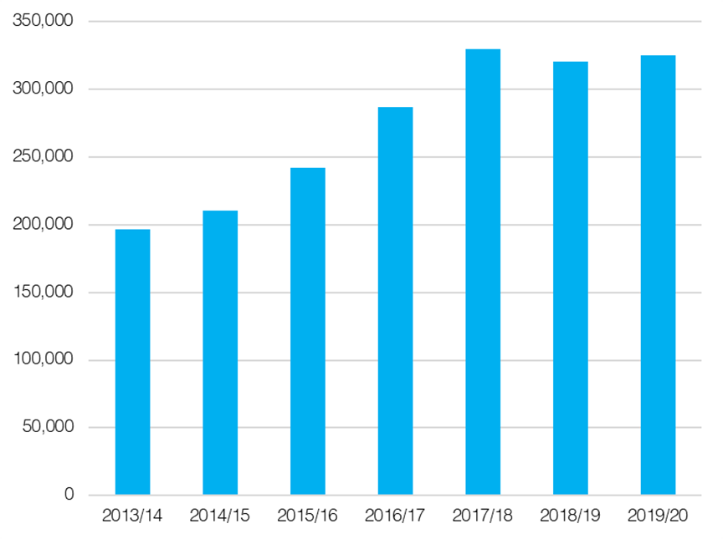
SOCIETY
Missing persons incidents
Notes:
Society is changing too in ways that pose new challenges for the police – in 3 respects – complex needs, victims of previously neglected forms of crime and abuse demanding justice, new patterns of social division and tension

Slide 8
SOCIETY
Recorded sexual offences

Slide 9
THREE CHALLENGES FOR POLICING
There is a capacity challenge: the police on their own cannot successfully tackle the range and complexity of these demands
There is a capability challenge: the police lack many of the capabilities required to tackle current and future challenges
There is an organisational challenge: the police do not posses the right organisational platform upon which they can deliver the capabilities required

Slide 10
2. THE CAPACITY CHALLENGE

Slide 11
PREVENTION
We need to do much more to prevent crime and harm from happening in the first place
Locally public services must be reorganised so they can take a whole place, whole person approach
Nationally we call for a new Crime Prevention Agency and a general duty on business to prevent crime

Slide 12
THE ROLE OF THE POLICE
We need to be clear about what it is we expect the police to do as part of a wider collaborative system. They should be deployed to manage risk where their skills and powers are necessary to the prevention of harm.

Slide 13
NEW POLICE MISSION
The core role of the police as being to promote public safety by maintaining order and upholding the law, which their unique powers enable them to do, and to carry out other activities which enable them to perform this core role legitimately, effectively and with minimum reliance on those powers.

Slide 14
3. THE CAPABILITY CHALLENGE
Notes:
Nb These are systemic rather than operational capabilities

Slide 15
SKILLS
LEARNING
LEGITIMACY
CAPABILITIES
TECHNOLOGY
LEADERSHIP
WELLBEING

Slide 16
4. THE ORGANISATIONAL CHALLENGE
Notes:
The local dimension is crucial but the current structure has 5 flaws: it is not designed to tackle cross border crime, it is not good at developing specialism, it is inefficient, the regional tier is too precarious and the centre is too weak

Slide 17
NATIONAL
An agency to prevent crime
An agency to tackle serious and organised crime
An agency to improve policing
REGIONAL
Organised crime
Specialist capabilities
Operational support and business support functions
LOCAL
24/7 response, local crime investigation, neighbourhood policing, safeguarding and offender management

Slide 18
5. Spotlight on Mental Health

Slide 19
THE CHALLENGE
Some police forces say mental health involved in 13 % of recorded incidents and a quarter of crimes.
s136 MHA 1983
36,594 detentions in year ending March 2022. 8% increase from previous year
London = 450% increase since 2013
1/3 taken into custody have mental health issues

Slide 20
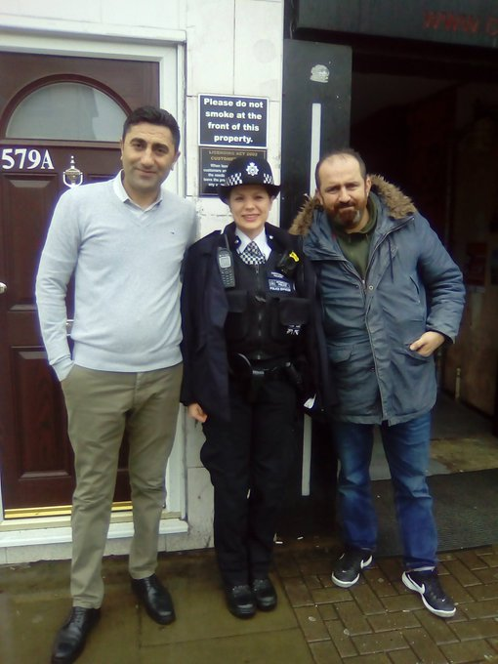
Too little specific training
Disproportionate use of force
Discriminatory attitudes
Disconnect between policy and frontline practice
Failure of information sharing
Lack of priority for mental health with ambulance service

Slide 21
SOME PROGRESS
Street triage/ mental health professionals in control rooms
Liaison and diversion in custody
More place of safety beds
Better training of police and understanding of diversion
Better screening and managing of detainee risk in custody

Slide 22
BUT…
The problem is not with the police as such but the extent to which we over-rely upon them as a de facto mental health and crisis care provider
Michael Brown – Mental Health Cop

Slide 23
BEST PRACTICE
Humberside Police Right Care Right Person
Proportion of mental health incidents to which police are deployed down from 63% to 47% between January 2019 – April 2020 vs May 2020 – October 2021
This equates to an average of 508 fewer deployments per month or monthly savings of nearly 1132 officer hours

Slide 24
WHAT WE CALL FOR

Slide 25
1. THE CHALLENGE

